Slide 1
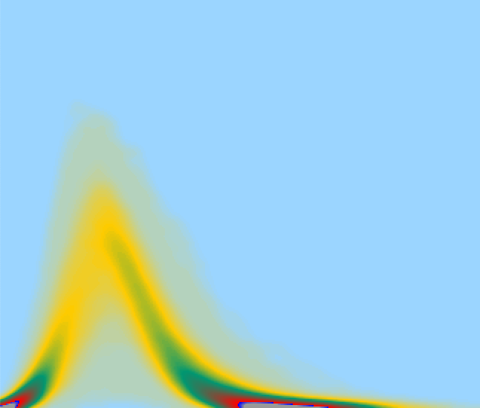
Random Infection Simulation*
Dr. Michael R. Alvers
last changed Tuesday, 5 May 2020
* work in progress

Slide 2
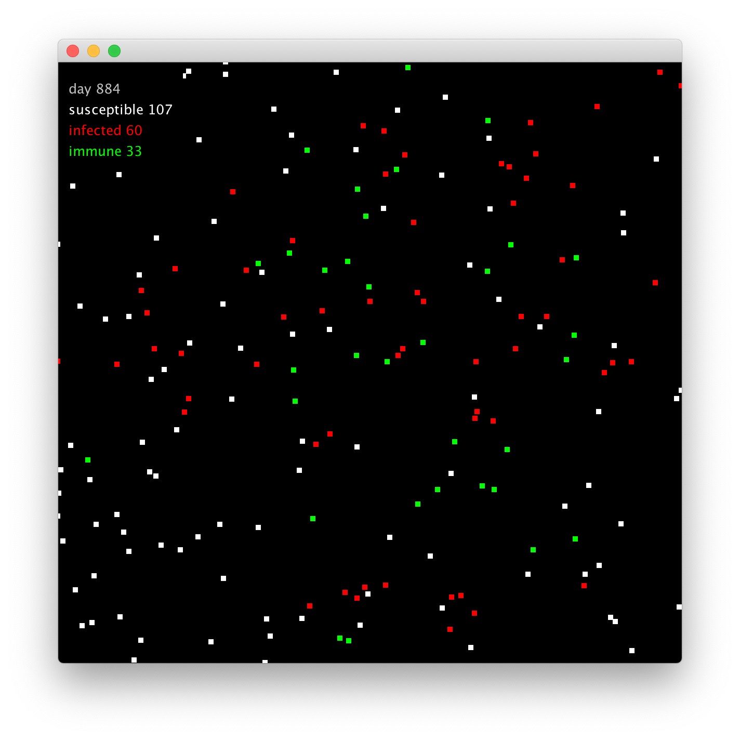
Simulation setup
The aim of this work is to investigate the variability in random walks with infection probability.
A very simple coronaverse is designed as follows ...

Slide 3
Simulation settings
500 individuals move per time step randomly within a box of one third of the whole coronaverse.
Two individuals can infect each other if the distance is below 5 units* of the coronaverse world size = 160 (infection ‘radius’** arbitrarily chosen).
infected individuals recover or die (can be removed) after 600 time steps (following ‘steps’).
4.000 simulations run in parallel for statistical coverage.
coronaverses are squared
world size = 160 units
* sayed if other numbers are used in the following simulations
** for performance reasons a box test is performed

Slide 4
Simulation settings (cont.)
coronaverses are squared
Investigated are these factors:
Infection probability
Individual size
Quarantine probability
Quarantine time
world size = 160 units
* sayed if other numbers are used in the following simulations
** for performance reasons a box test is performed

Slide 5
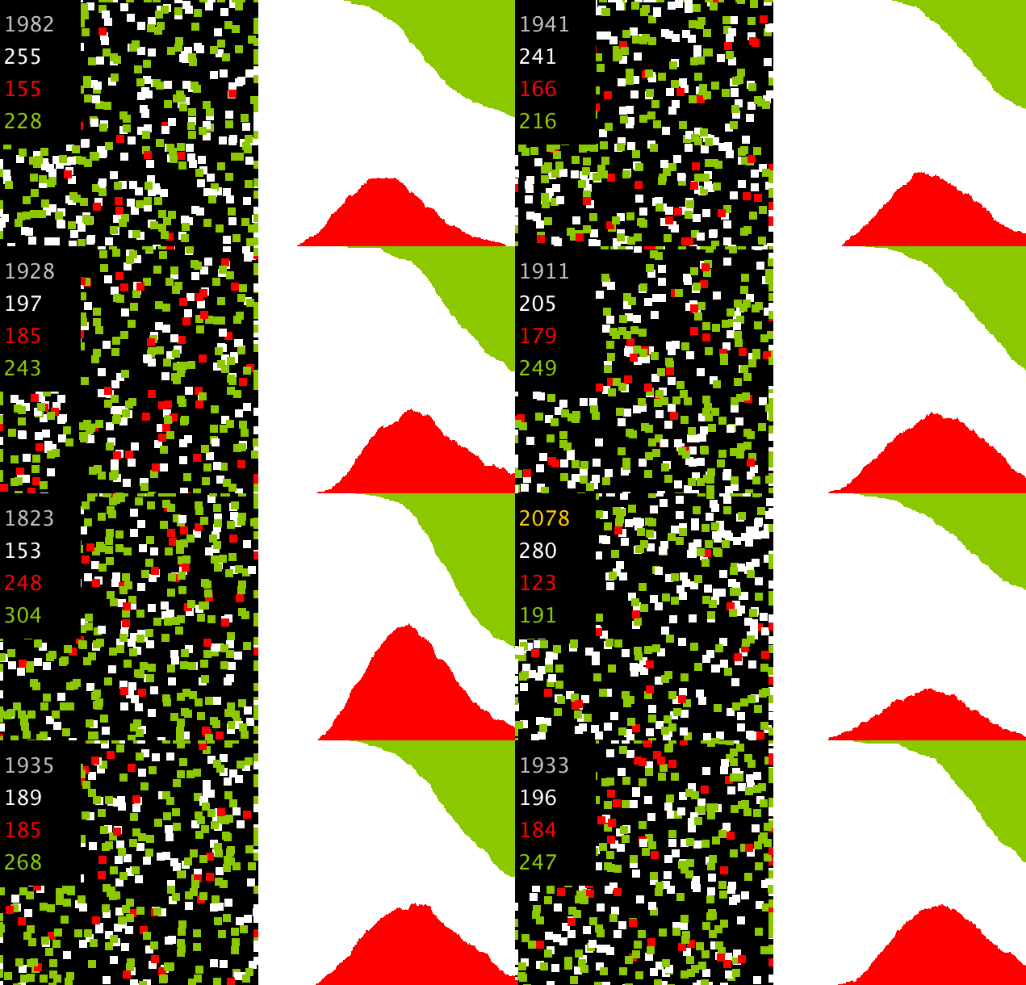
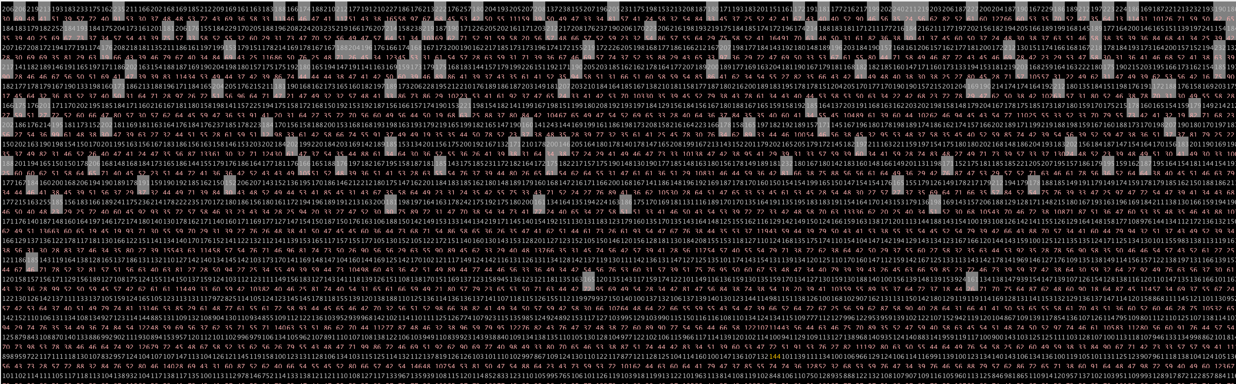
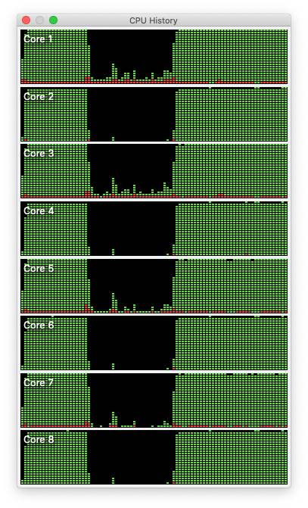
Example Simulations
4.000 simulation run in parallel
green: recovered, red: infected, white never infected
8 cores 2.8 GHz

Slide 7
Infection probability

Slide 8
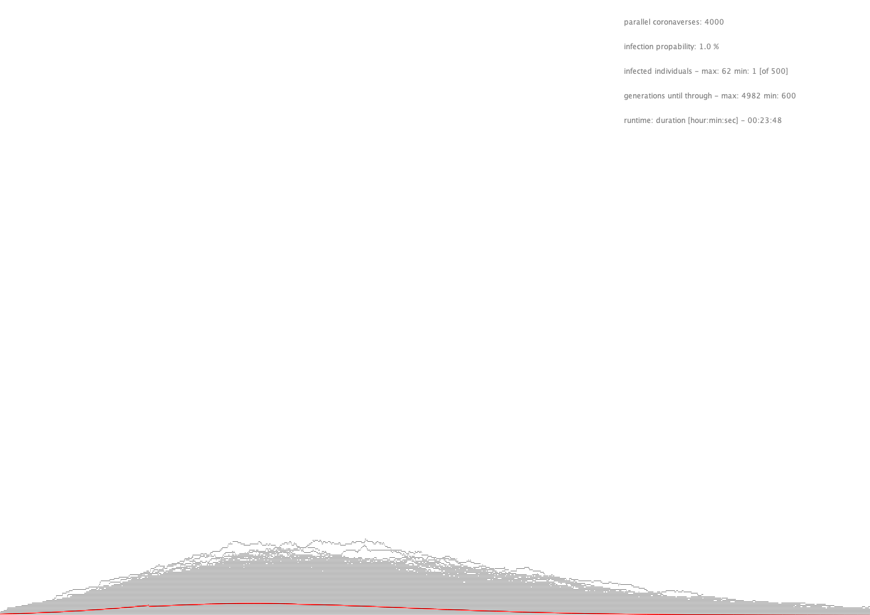
100 %
worst and best case scenarios
runtime about 30 minutes
1 %
3500 steps

Slide 9
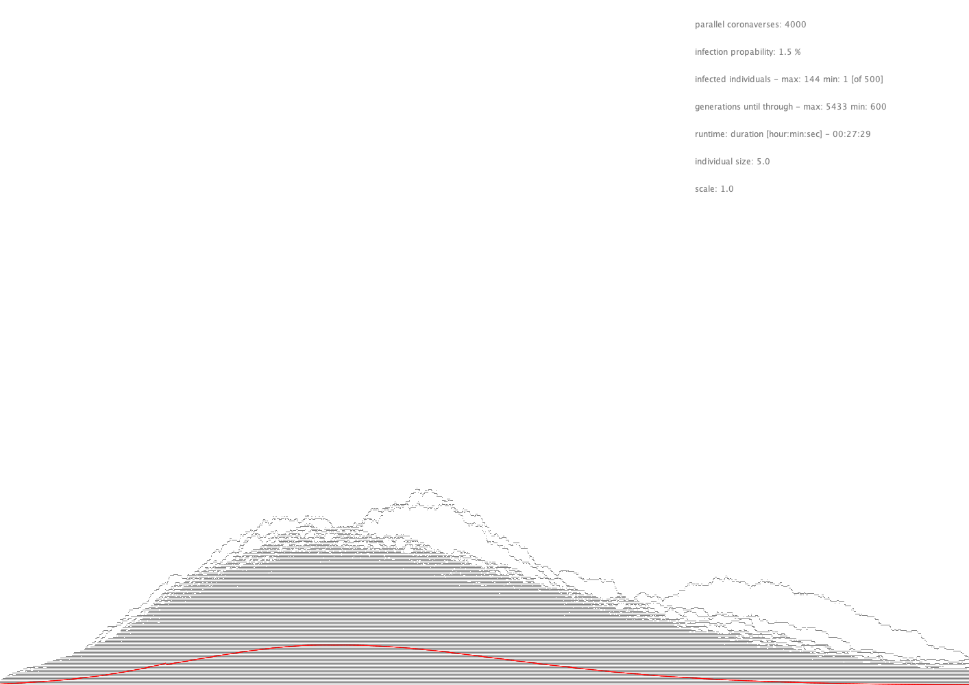
100 %
1.5 %
3500 steps

Slide 10
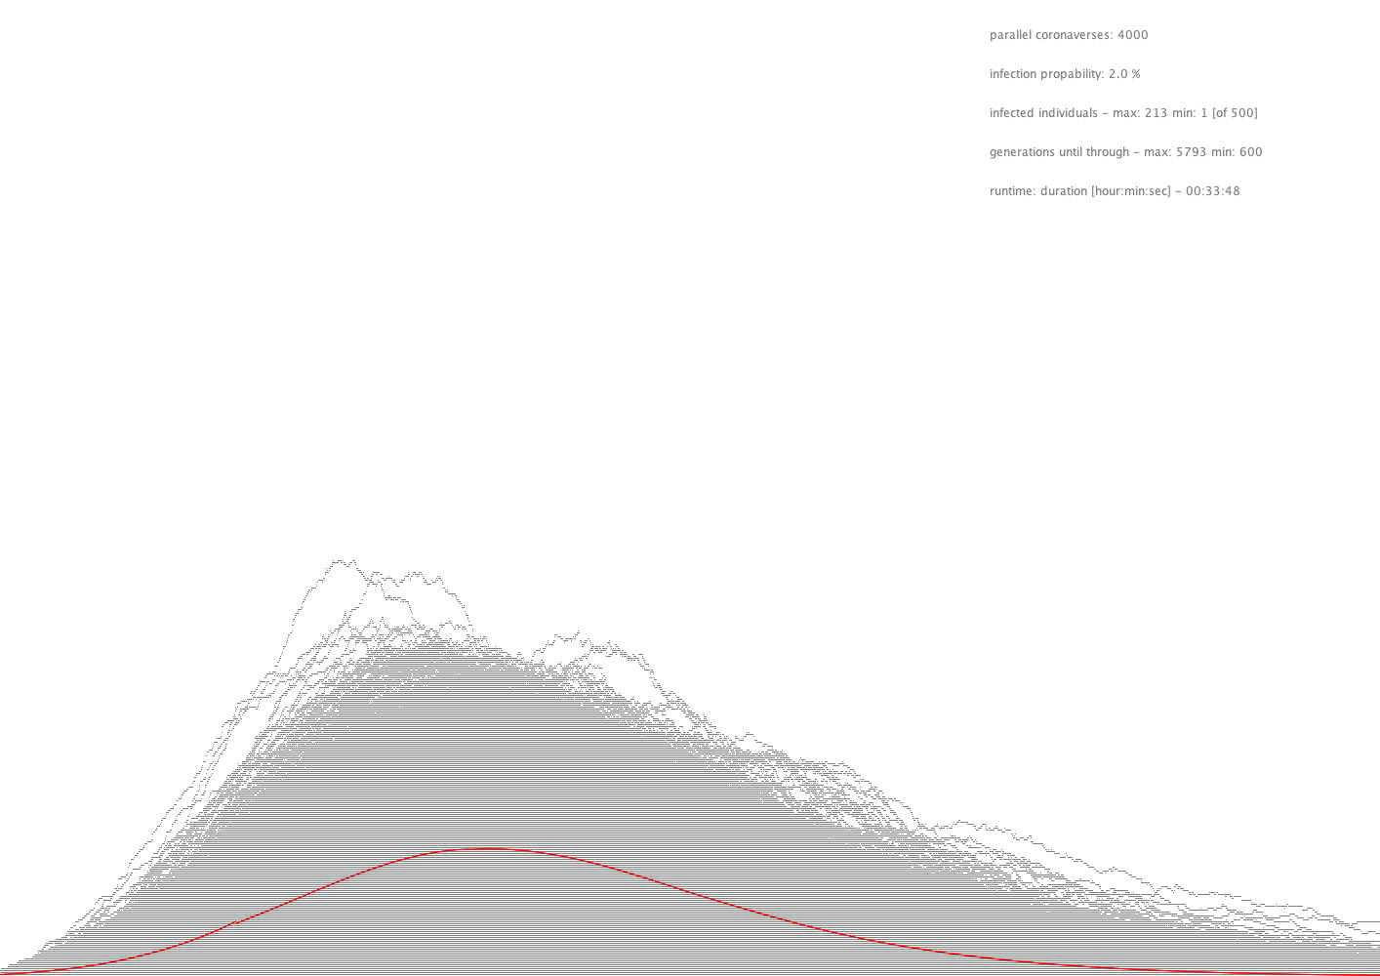
100 %
worst case scenario
average of 4.000 simulations
2 %
best case scenario
3500 steps

Slide 11
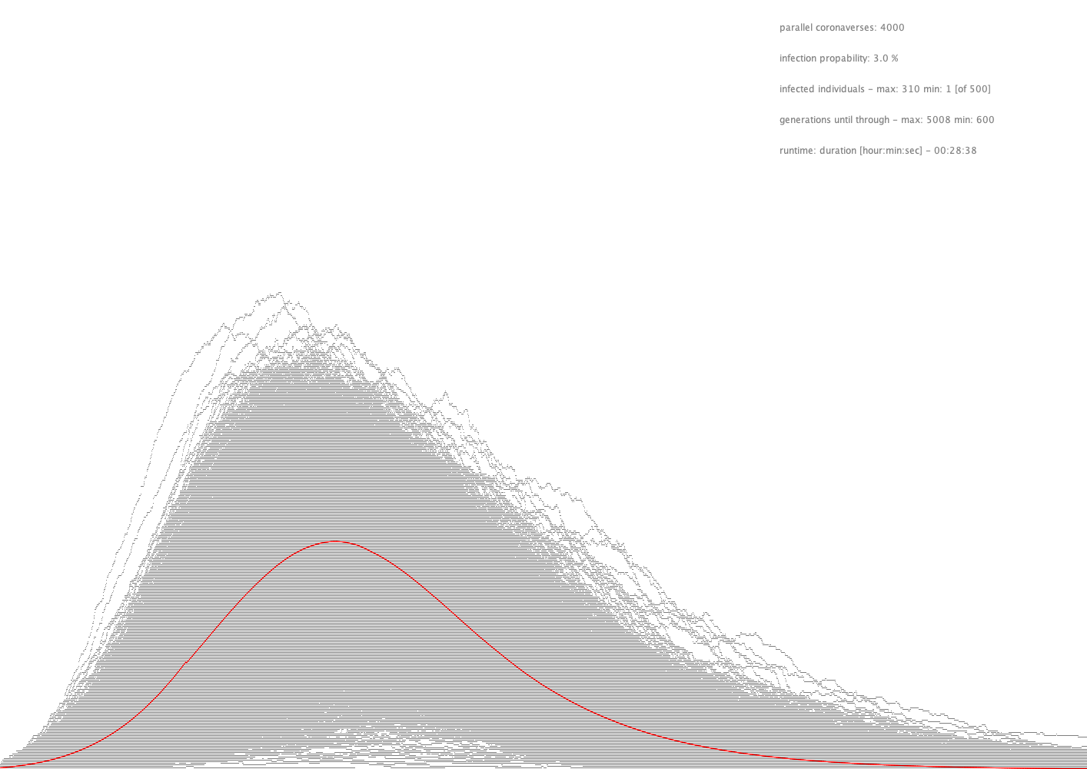
100 %
3 %
3500 steps

Slide 12
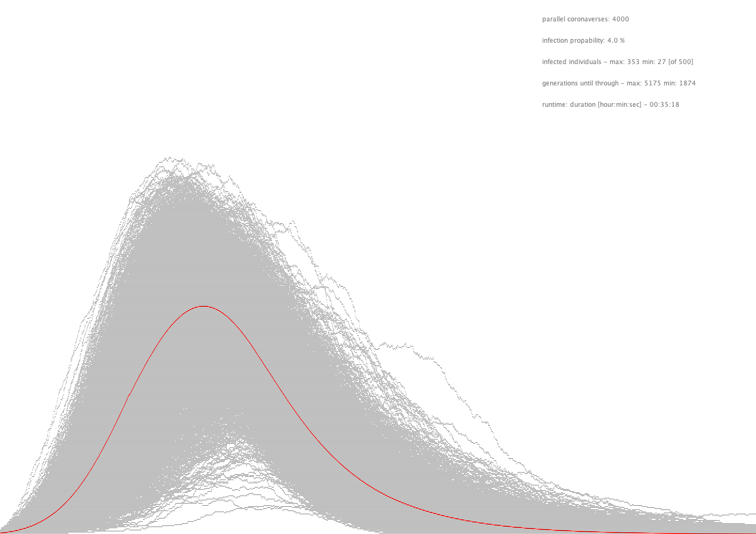
100 %
3500 steps

Slide 13
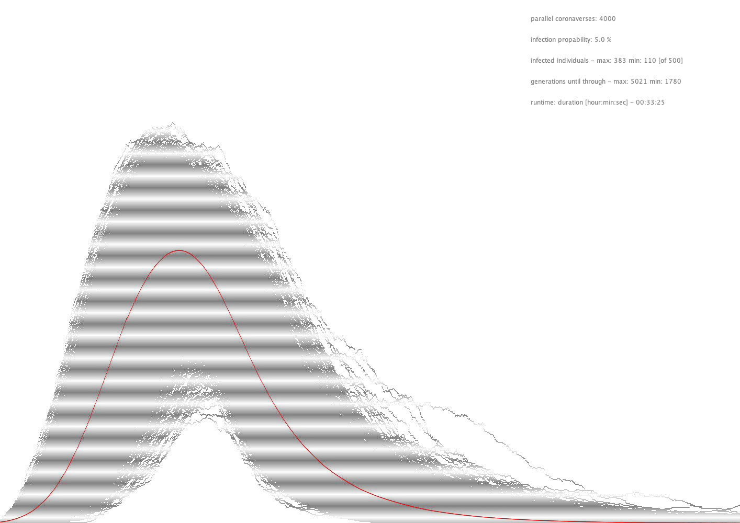
100 %
3500 steps

Slide 14
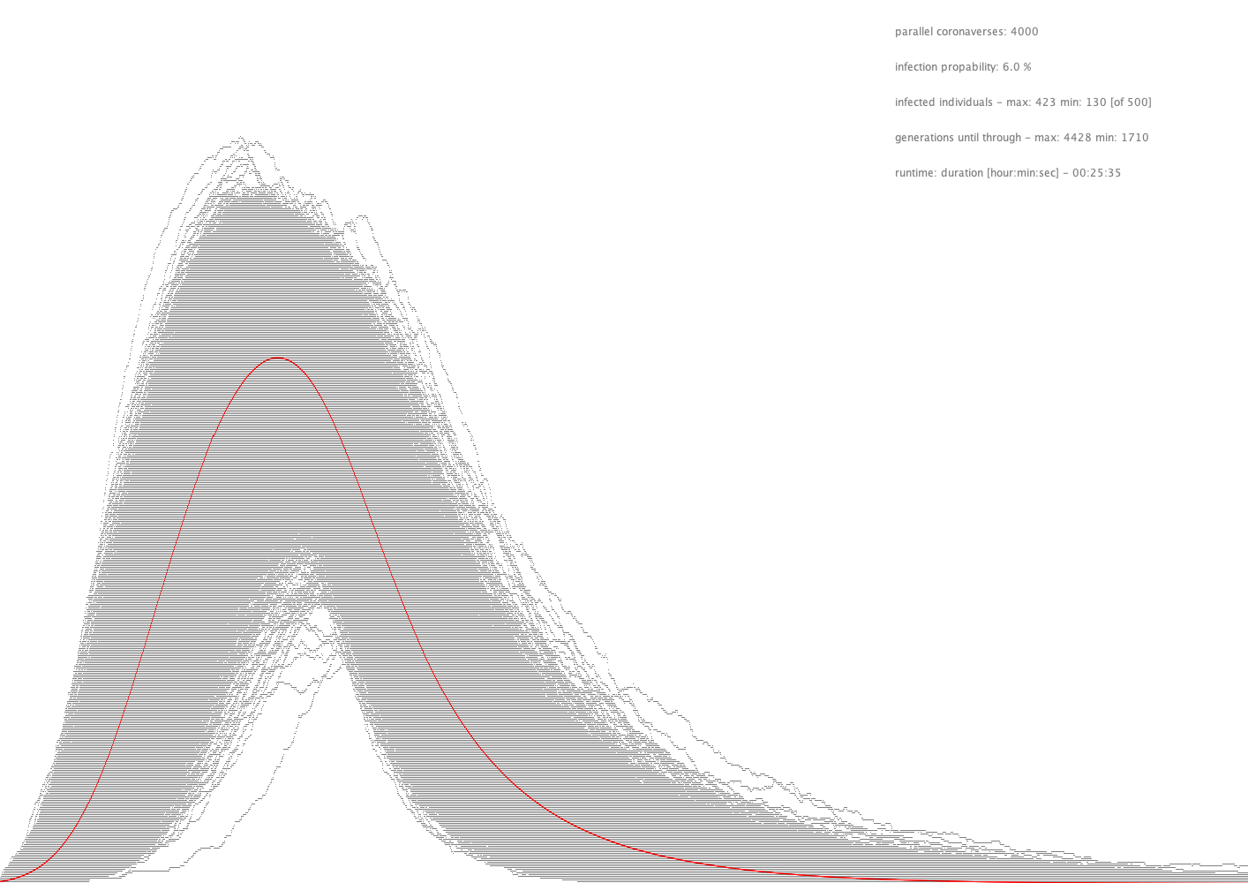
100 %
3500 steps

Slide 15
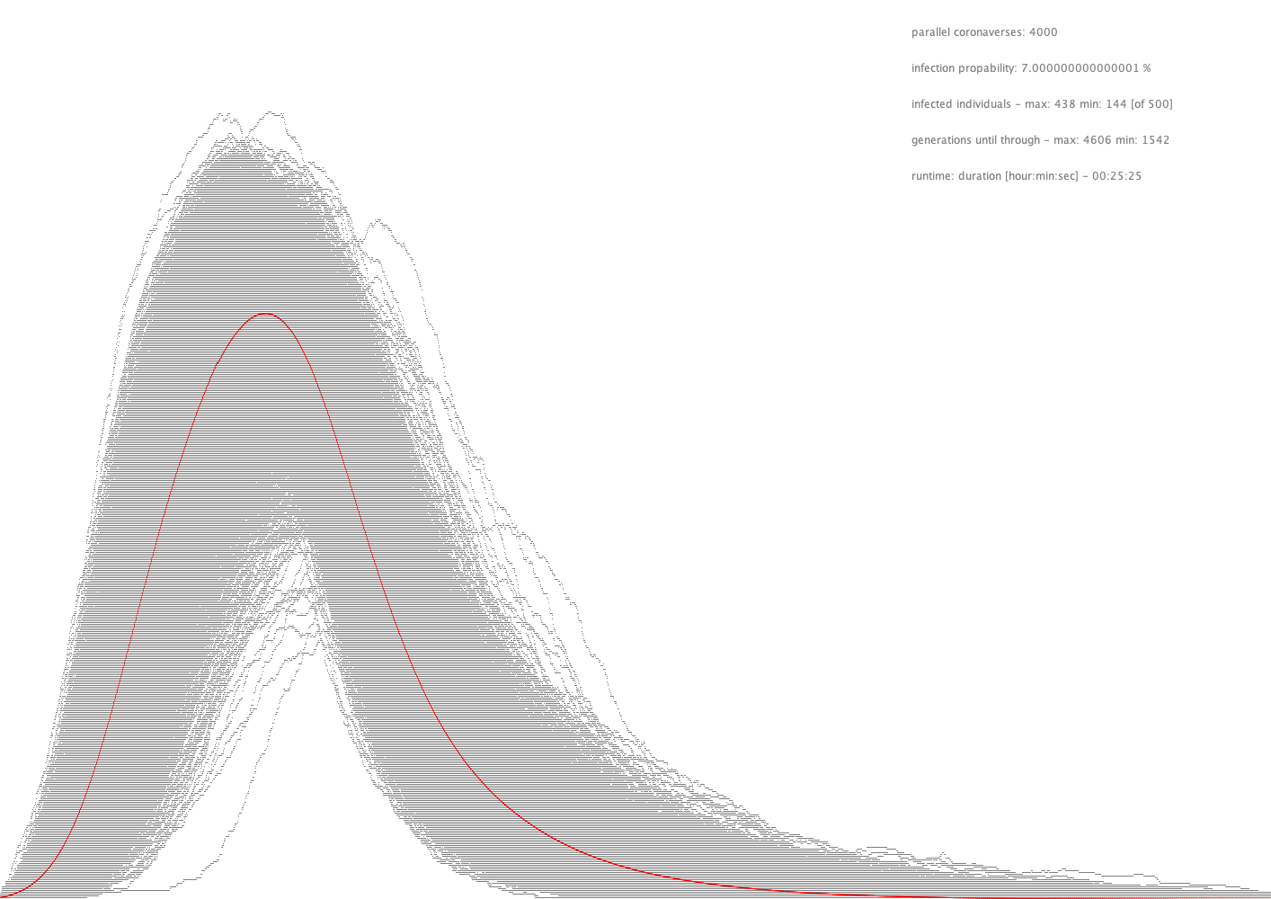
100 %
3500 steps

Slide 16
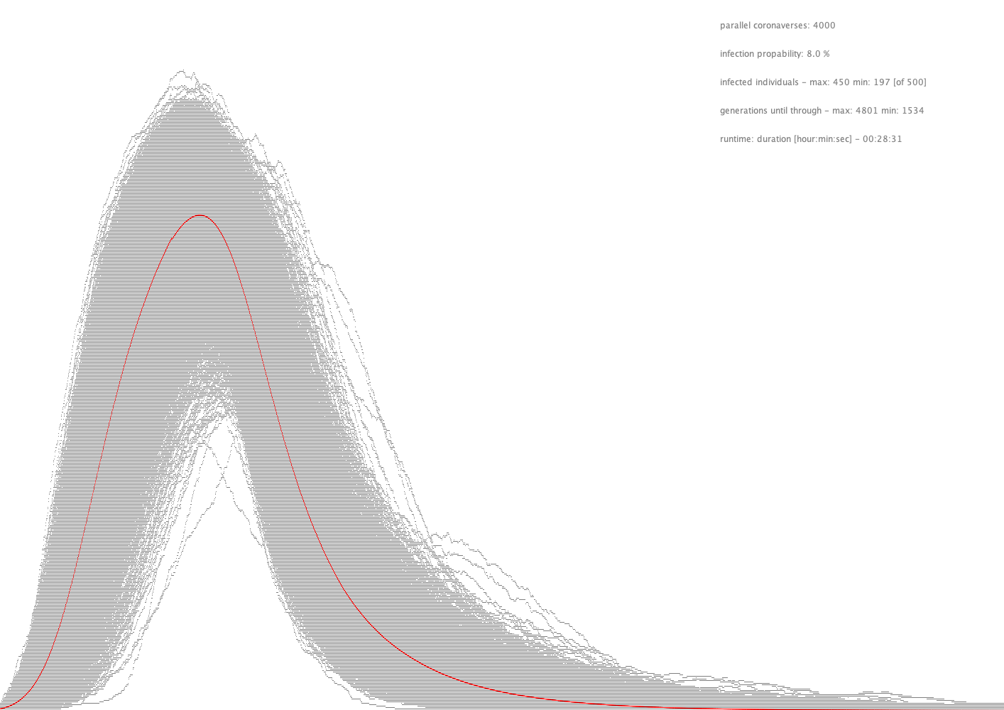
100 %
3500 steps

Slide 17
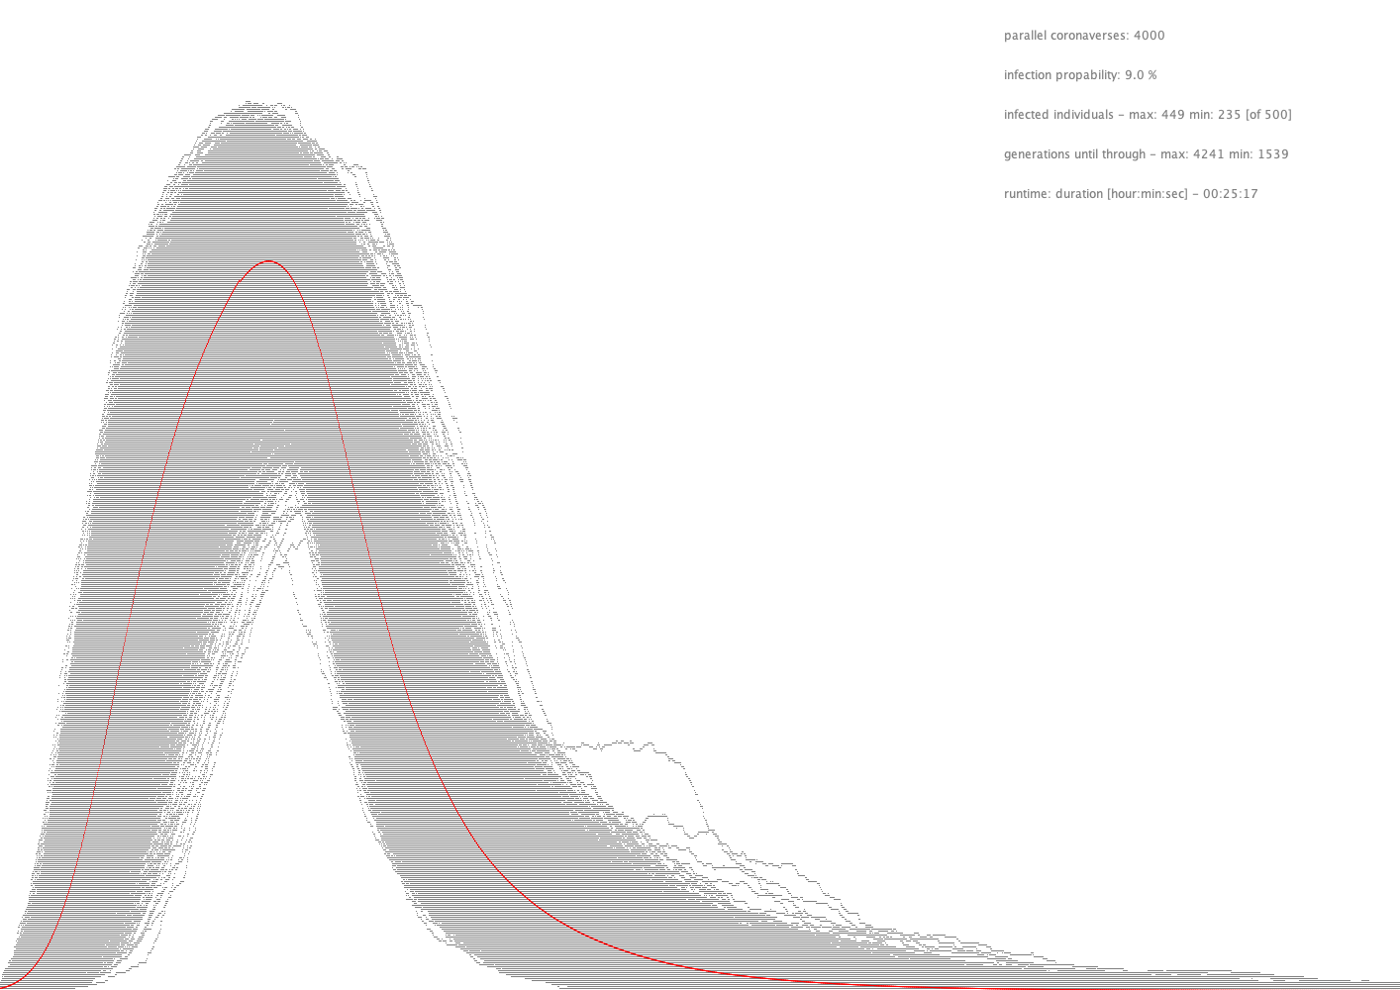
100 %
3500 steps

Slide 18
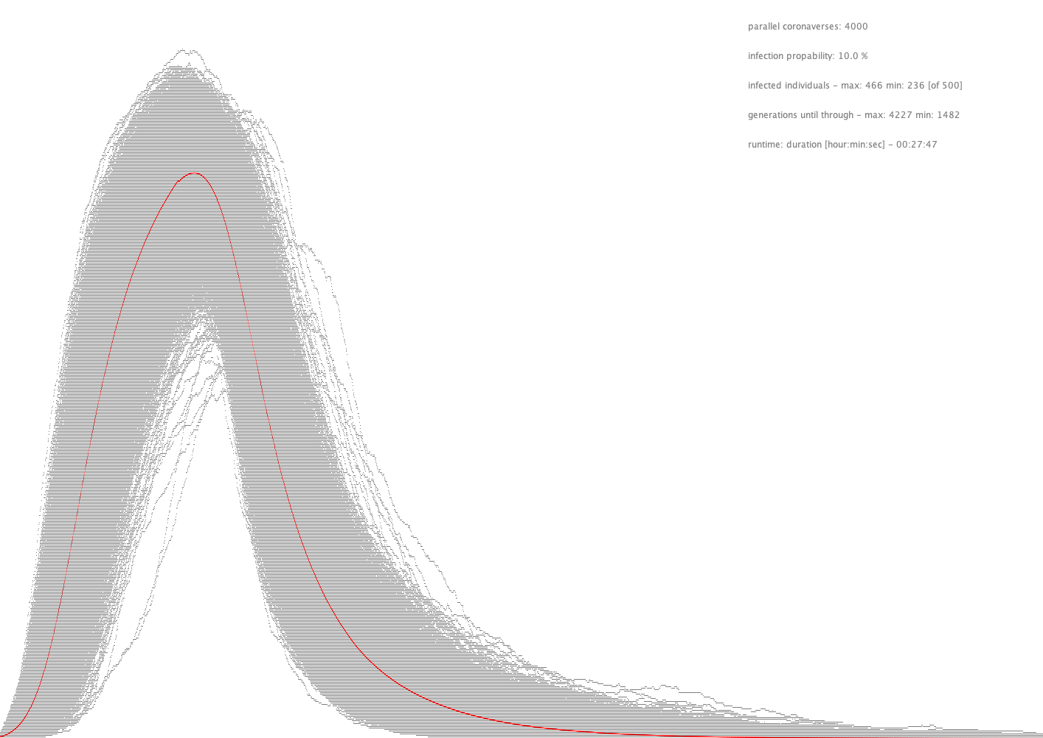
100 %
3500 steps

Slide 19
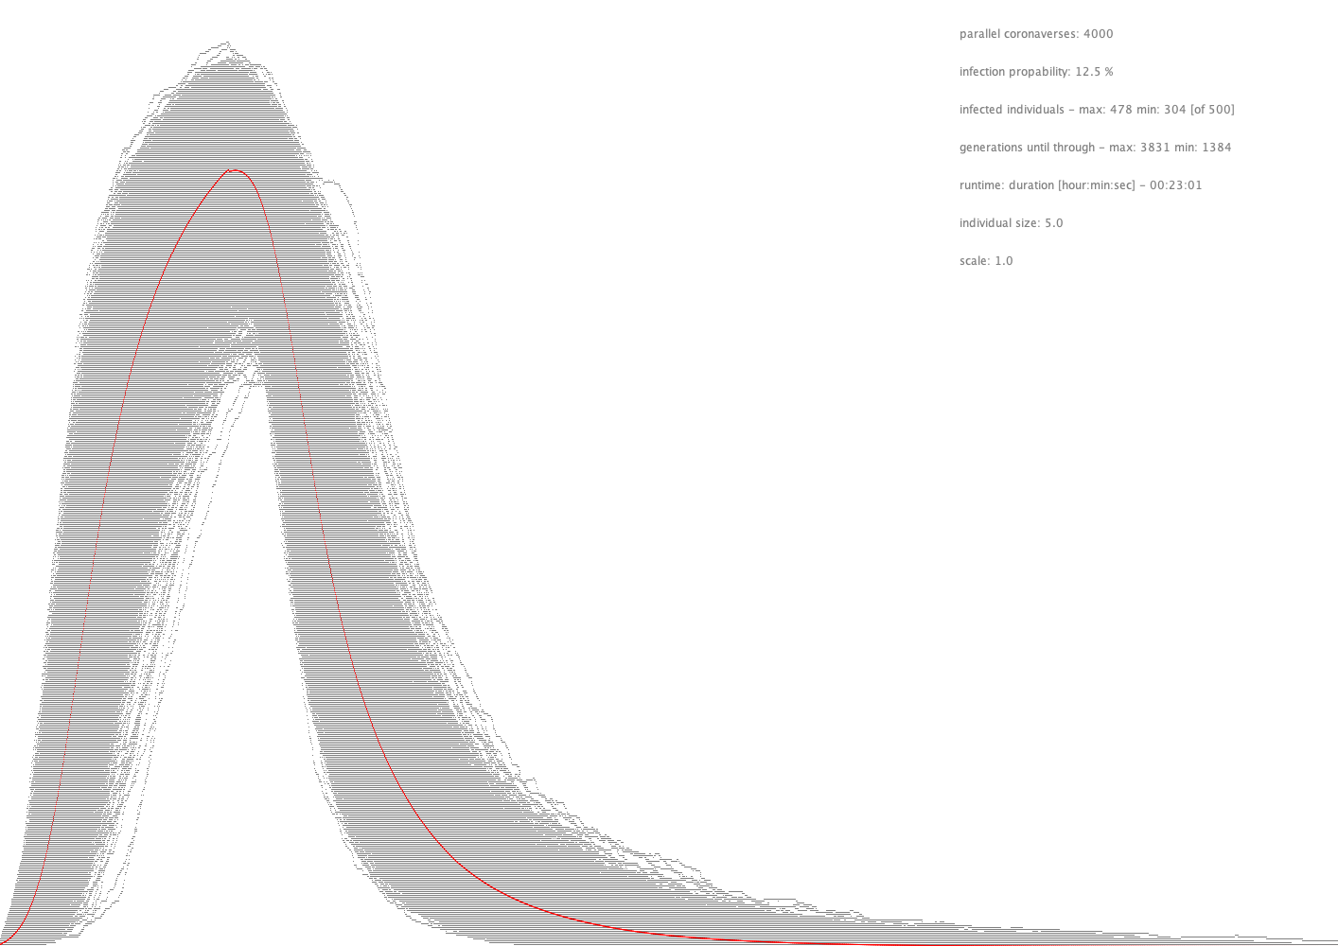
100 %
3500 steps

Slide 20
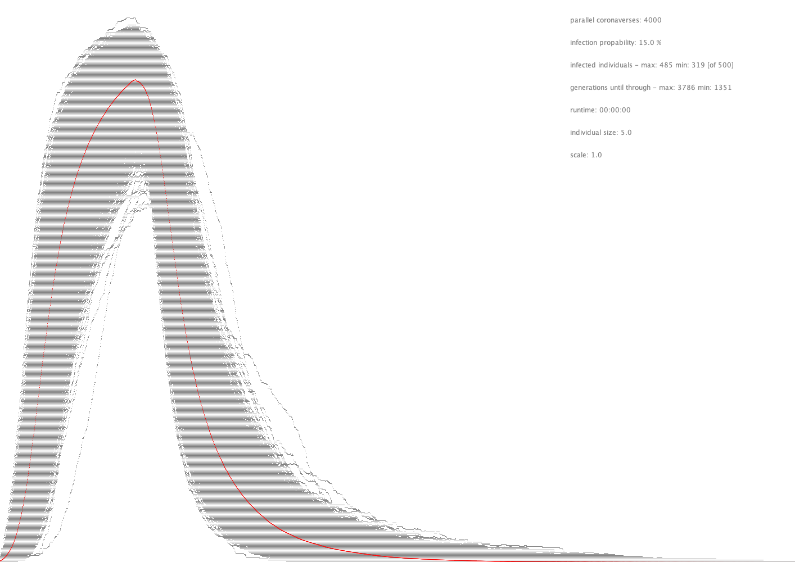
100 %
3500 steps

Slide 21
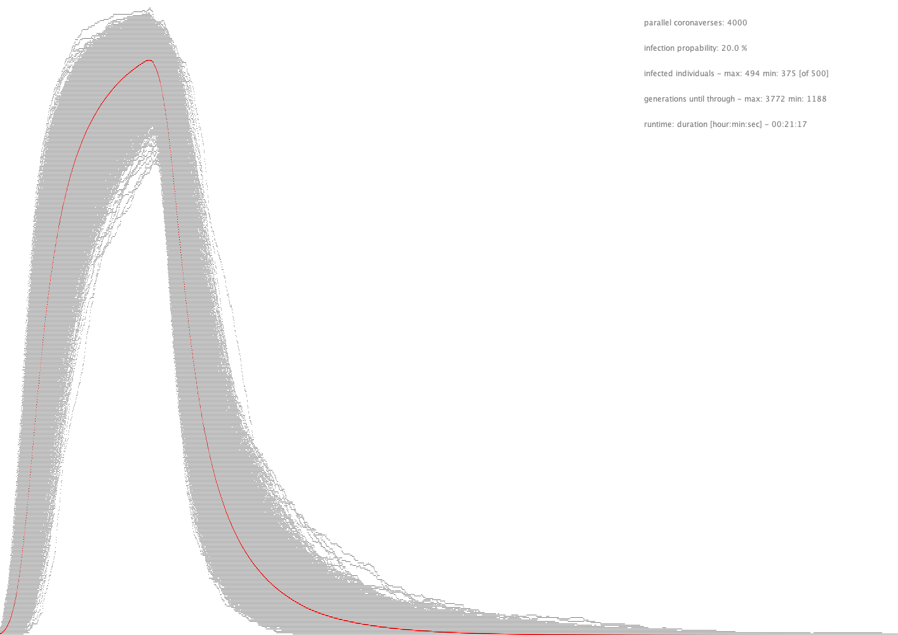
100 %
3500 steps

Slide 22
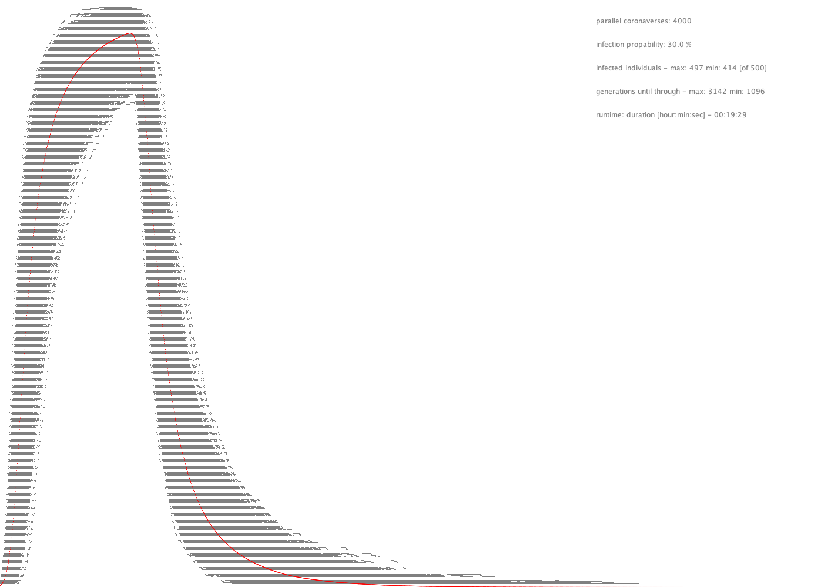
100 %
3500 steps

Slide 23
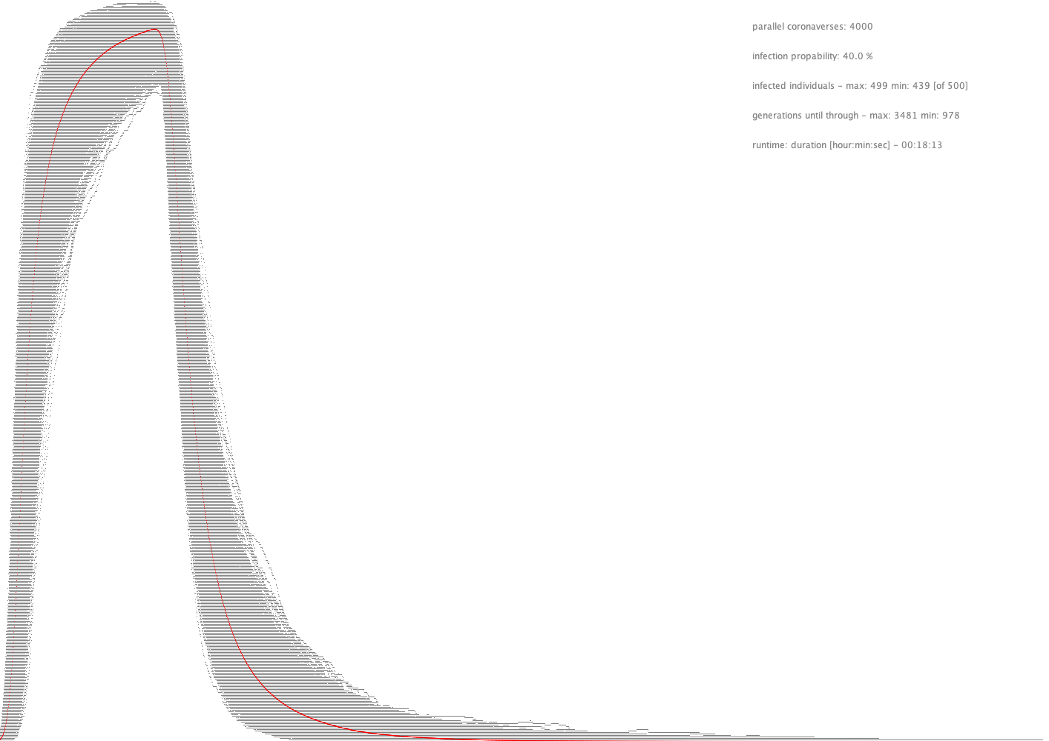
100 %
3500 steps

Slide 24
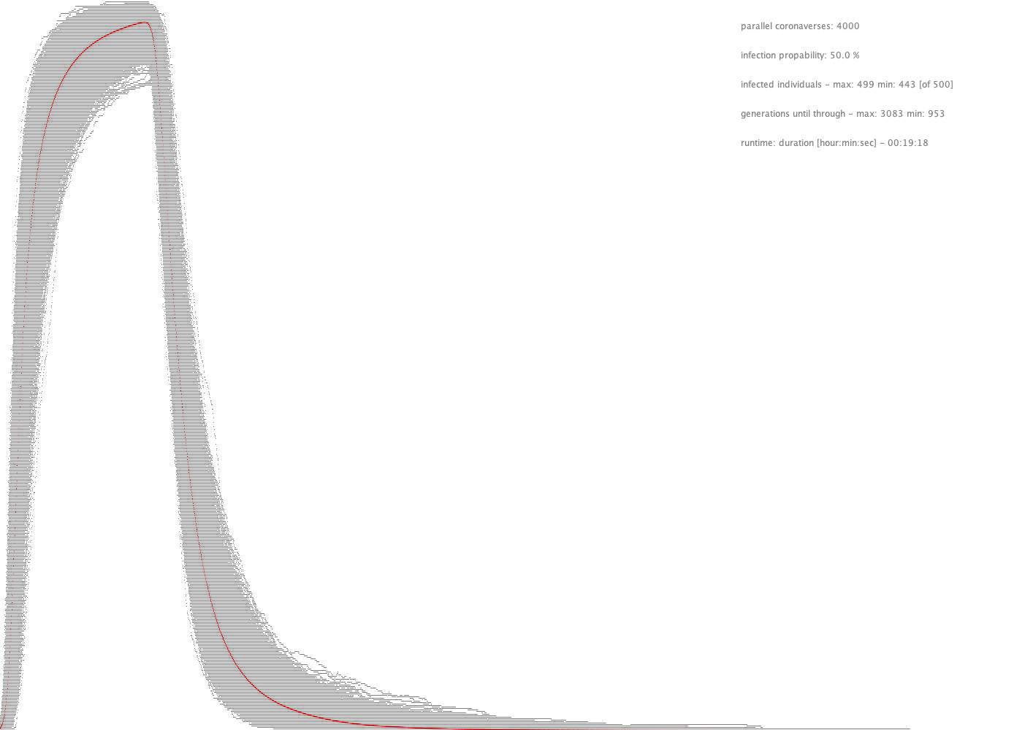
100 %
3500 steps

Slide 25
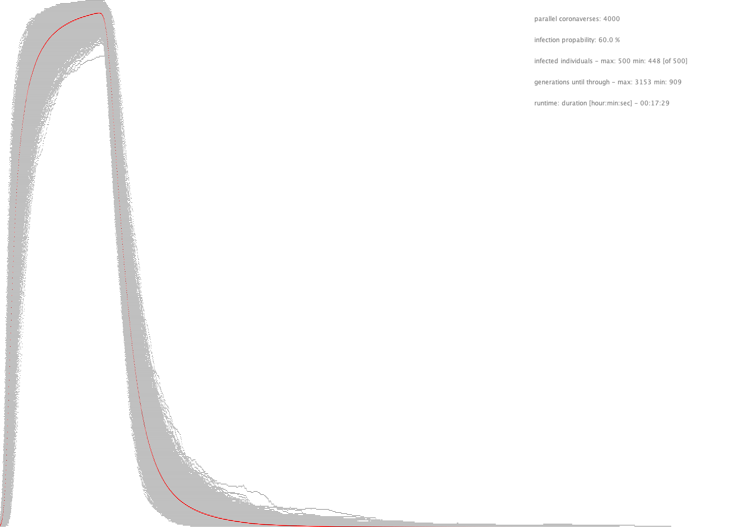
100 %
3500 steps

Slide 26
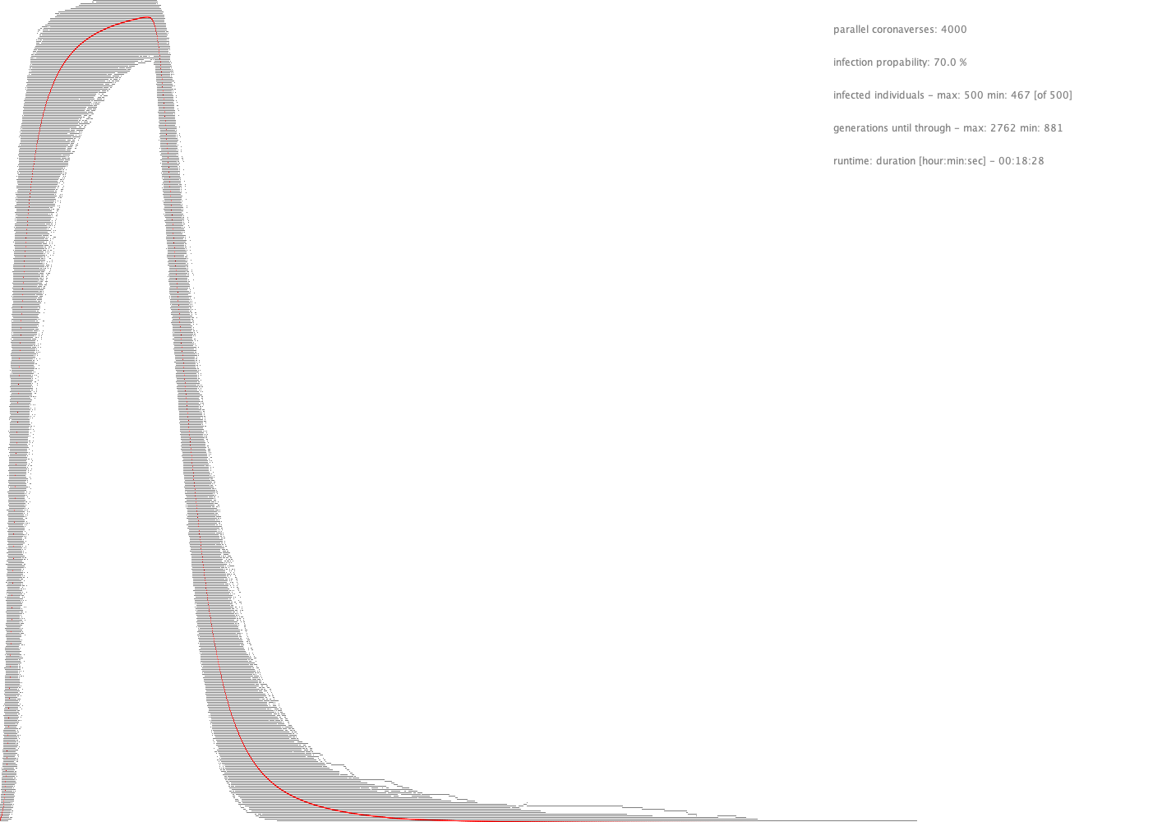
100 %
3500 steps

Slide 27
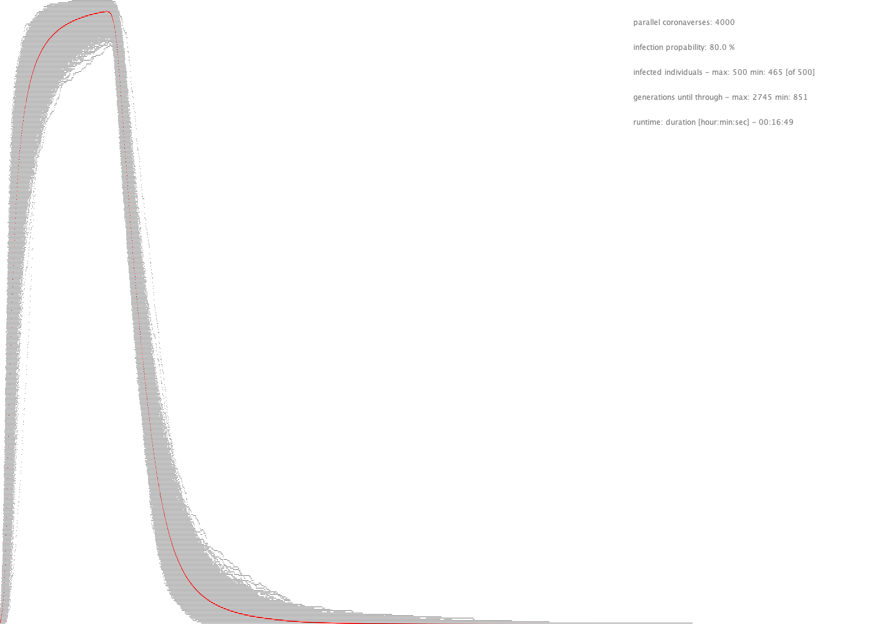
100 %
3500 steps

Slide 28
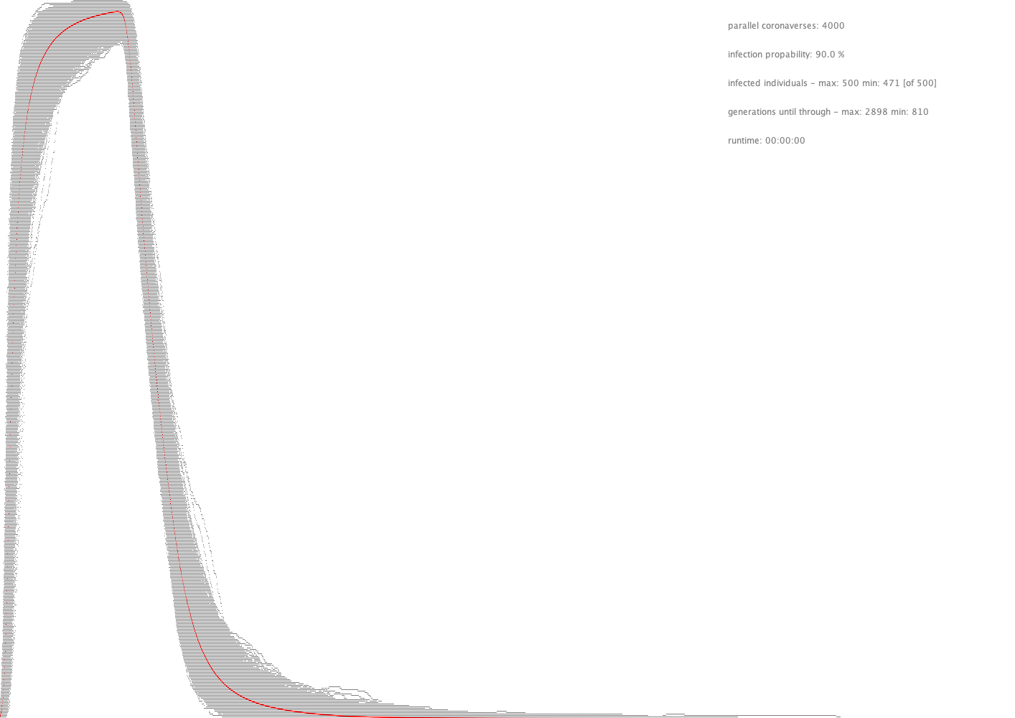
100 %
3500 steps

Slide 29
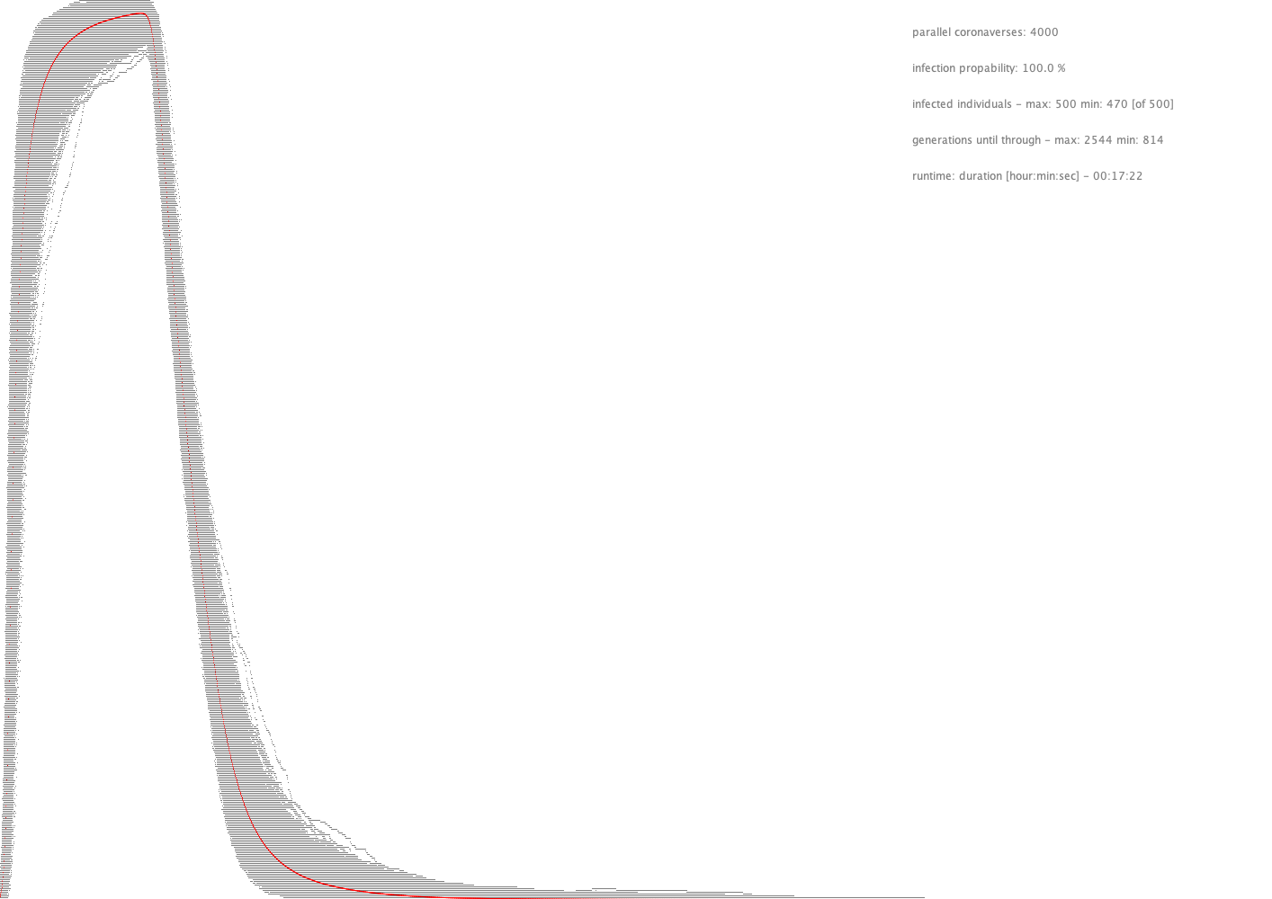
100 %
3500 steps

Slide 30
Learnings
The variability is extremely high especially for smaller infection probabilities.
For higher infection probabilities the time until the whole population is “through” is shorter but much more individuals are infected.

Slide 31
Range of movement

Slide 32
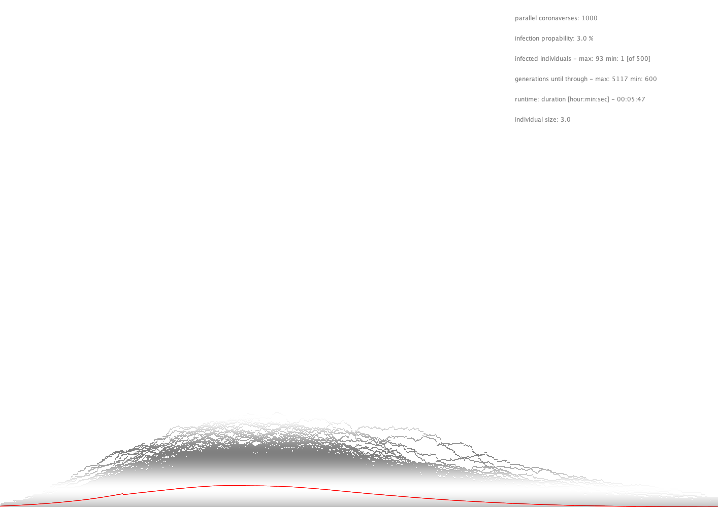
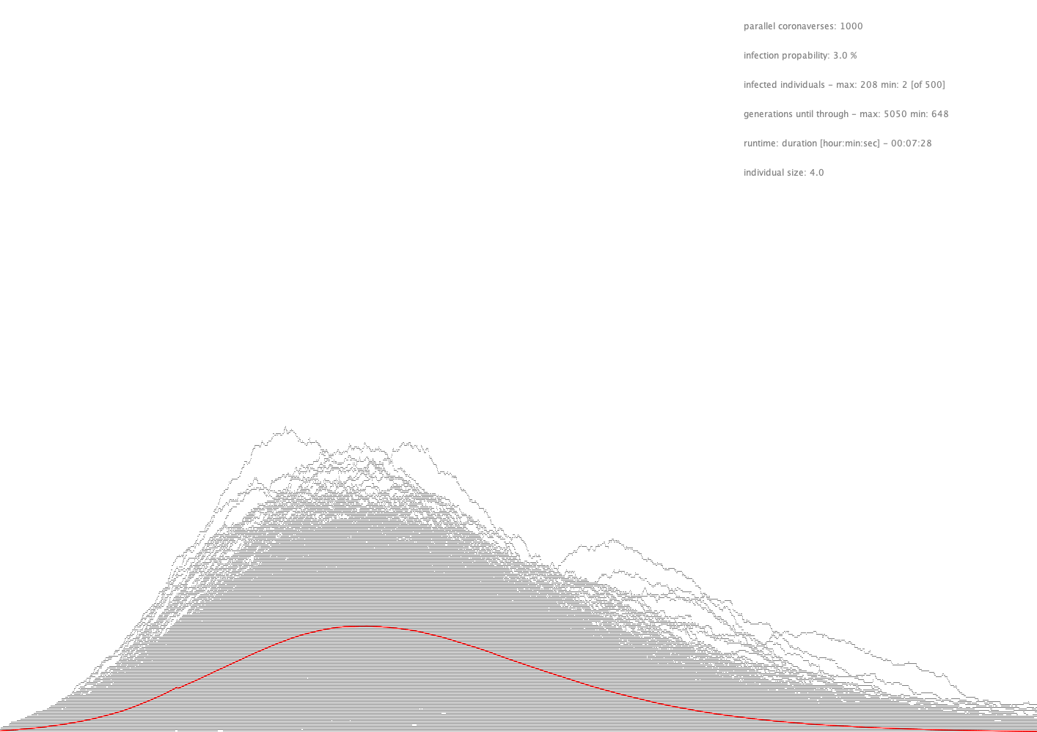
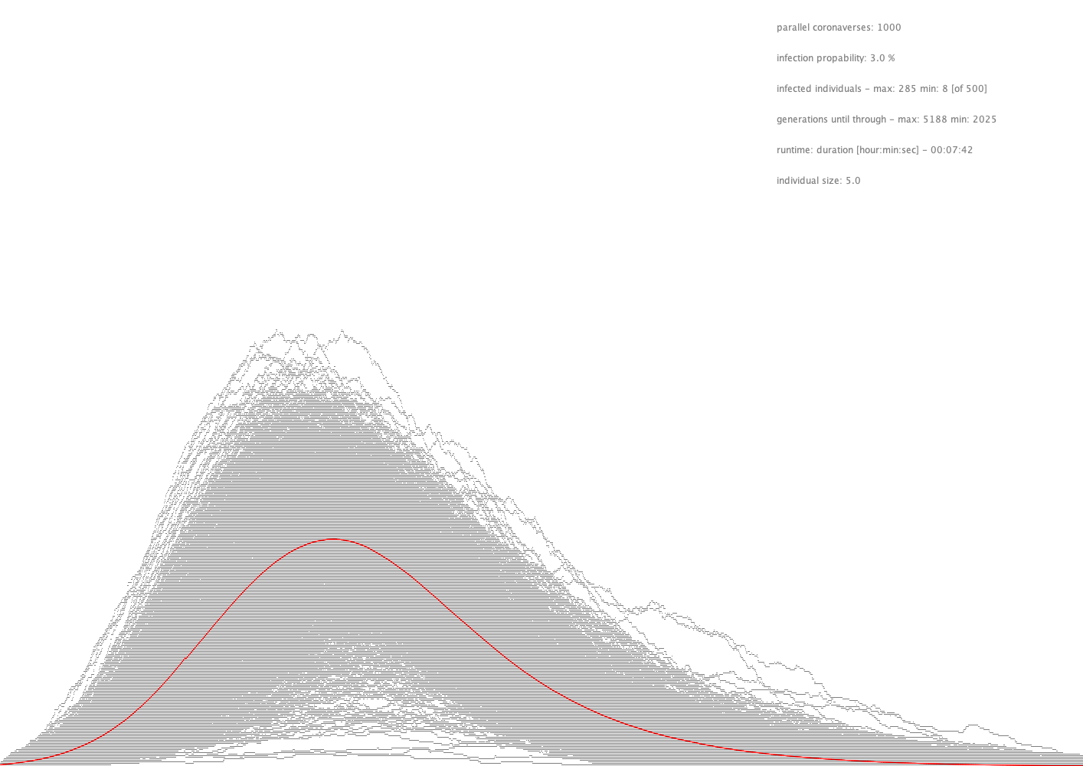
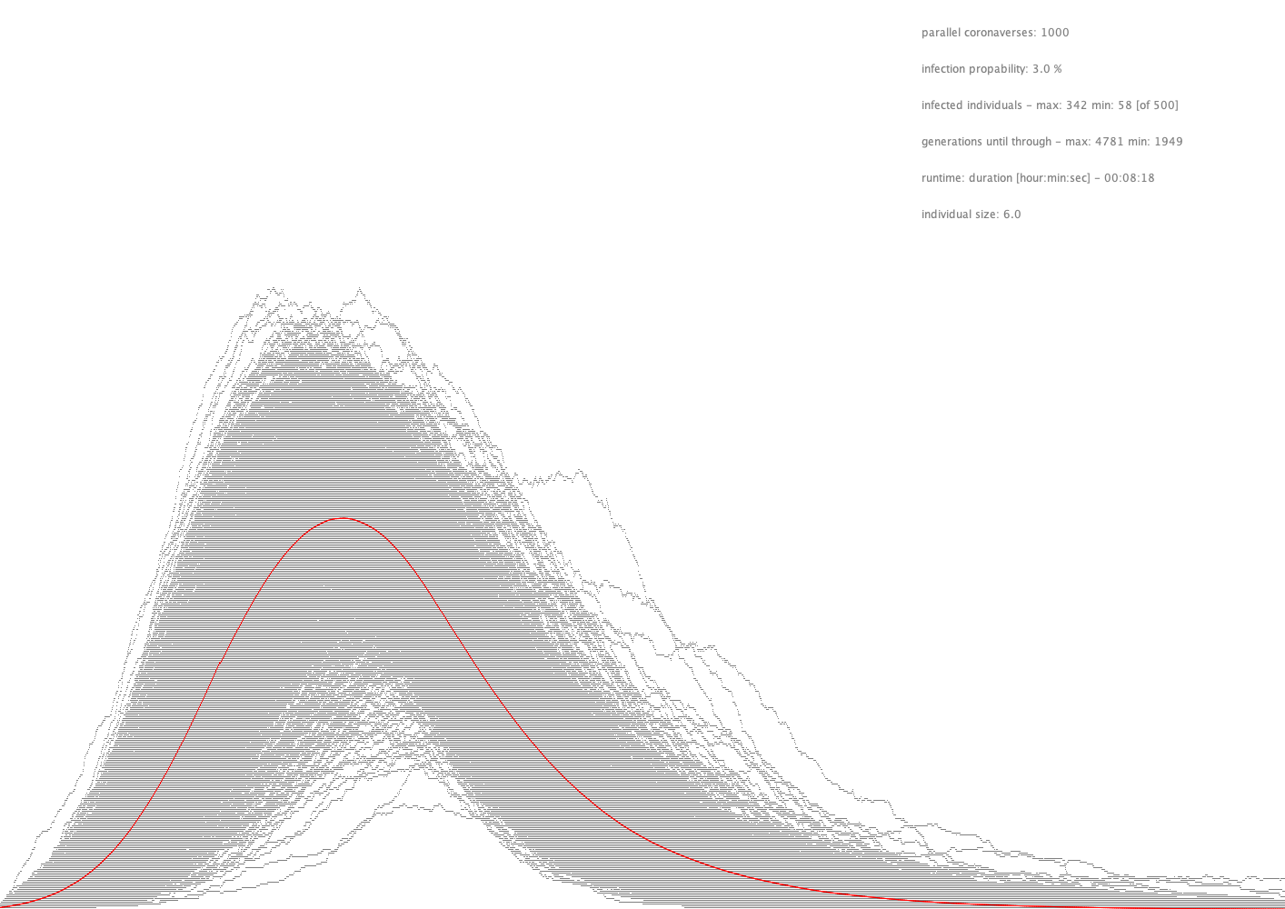
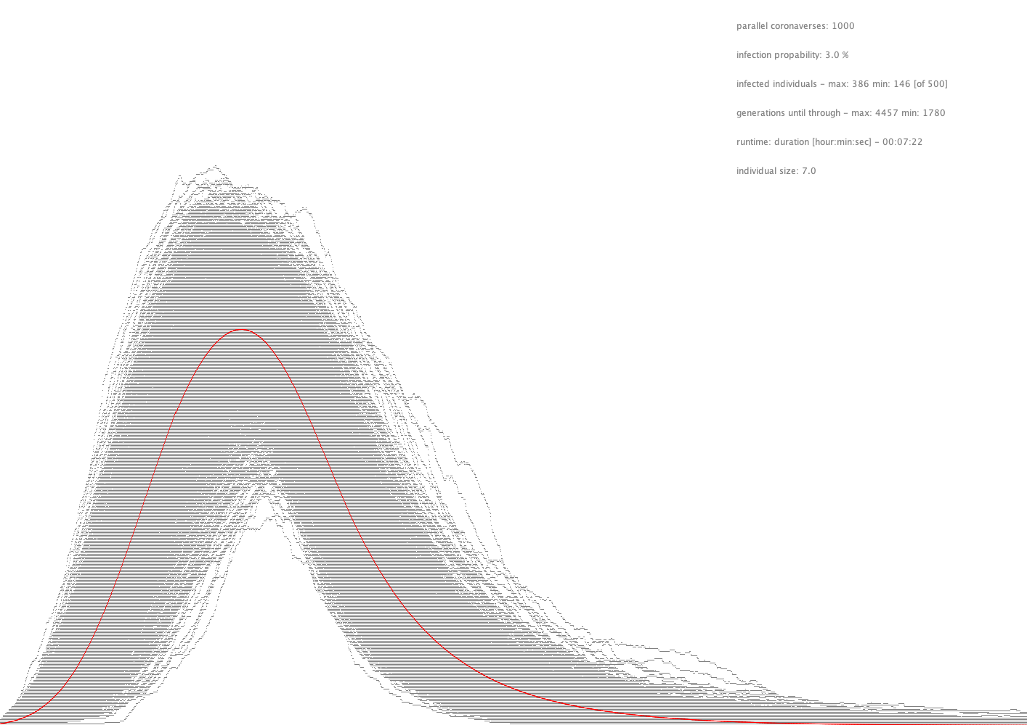
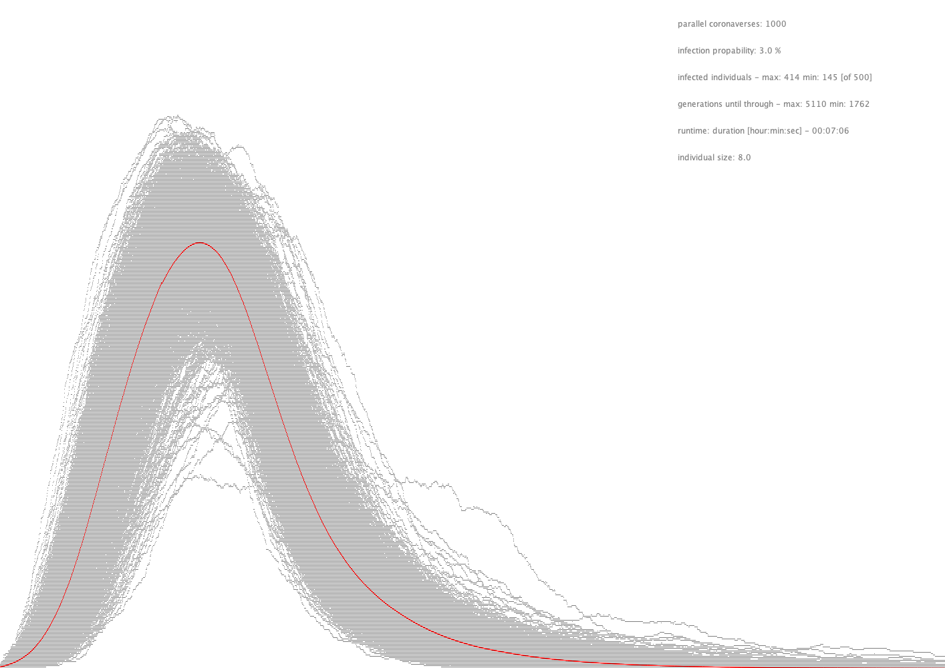
Influence of Individual Size (Infection radius)
3 units (of 160)
4 units (of 160)
5 units (of 160)
6 units (of 160)
7 units (of 160)
8 units (of 160)

Slide 33
Learnings
The range of movement which can be interpreted as social distancing has (expectedly) ‘more or less’ the same effect as infection probability.
Smaller movements = flatter curve.

Slide 34
Quarantine Probability

Slide 35
100 %
No quarantined after 300 steps
of 600 infection time
3500 steps

Slide 36
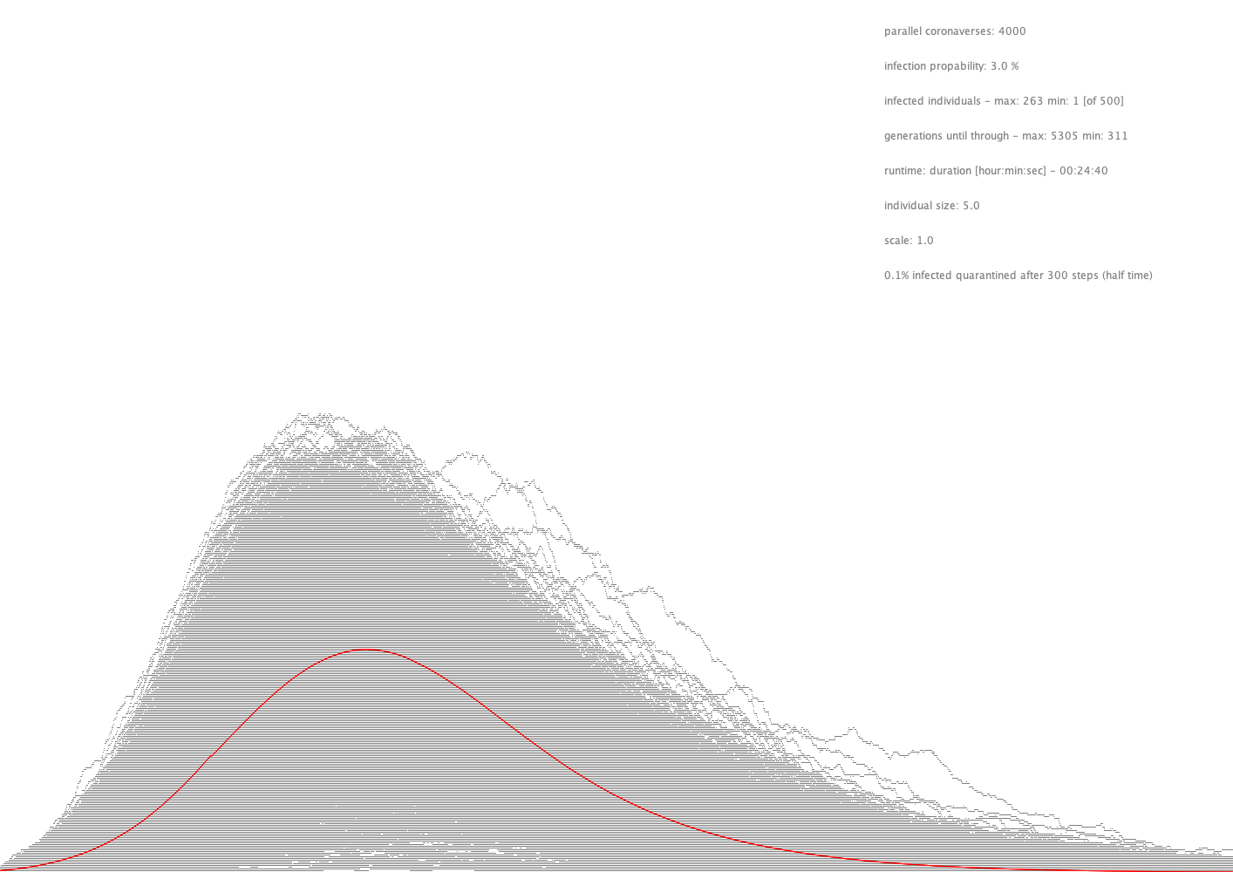
100 %
0.1% quarantined after 300 steps
3500 steps

Slide 37
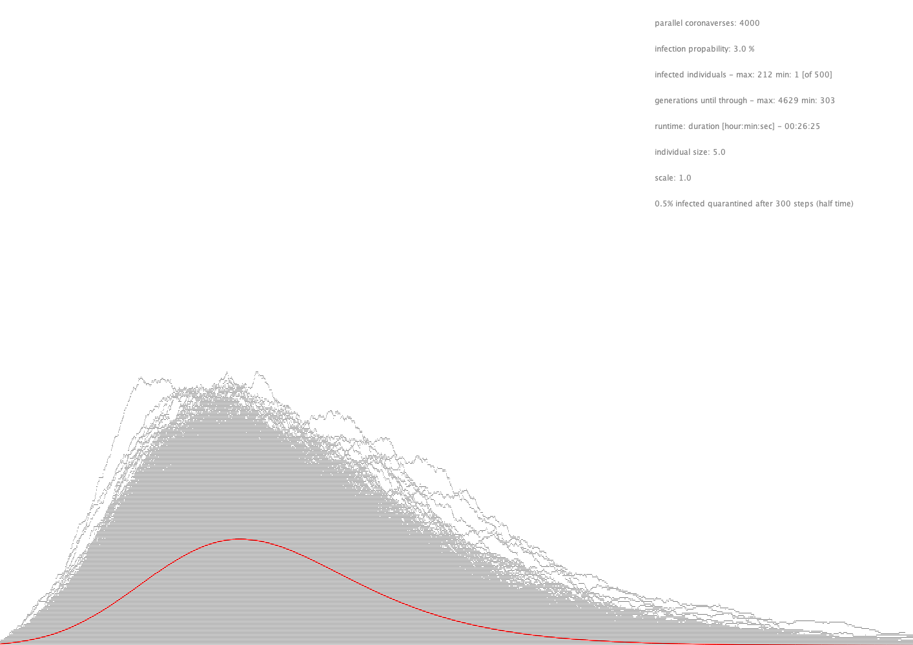
100 %
0.5% quarantined after 300 steps
3500 steps

Slide 38
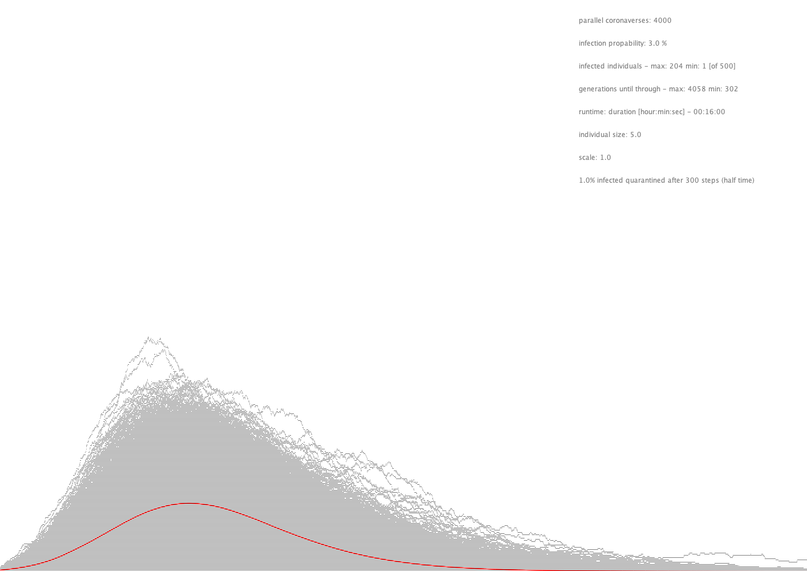
100 %
1.0% quarantined after 300 steps
3500 steps

Slide 39
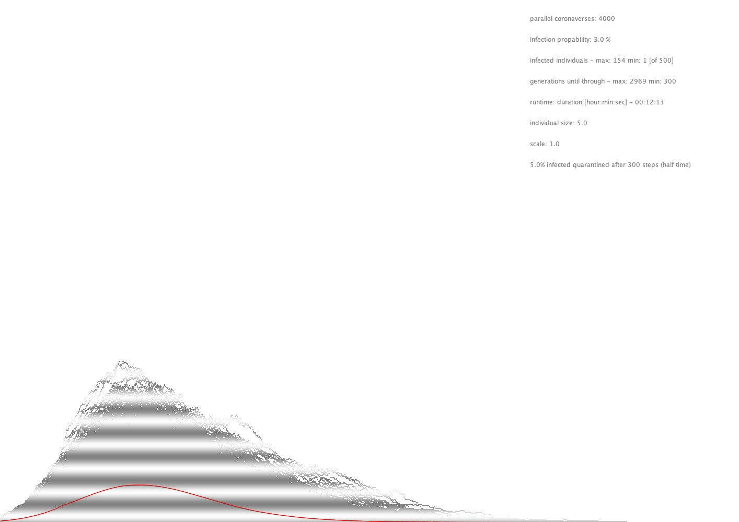
100 %
5.0% quarantined after 300 steps
3500 steps

Slide 40
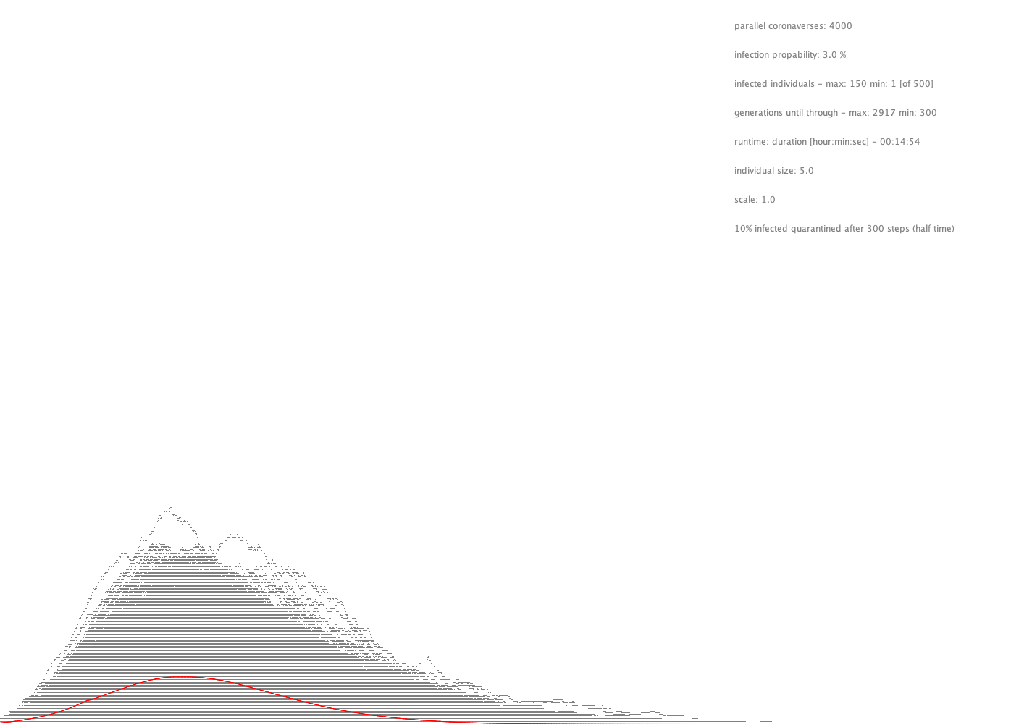
100 %
10% quarantined after 300 steps
3500 steps

Slide 41
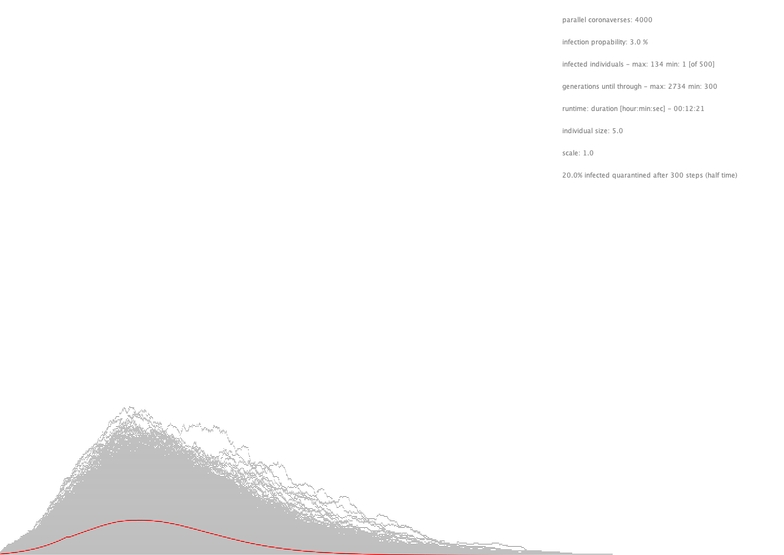
100 %
20% quarantined after 300 steps
3500 steps

Slide 42
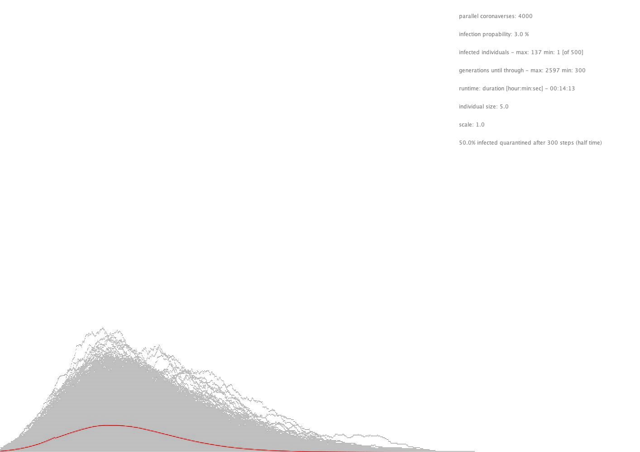
100 %
50% quarantined after 300 steps
3500 steps

Slide 43
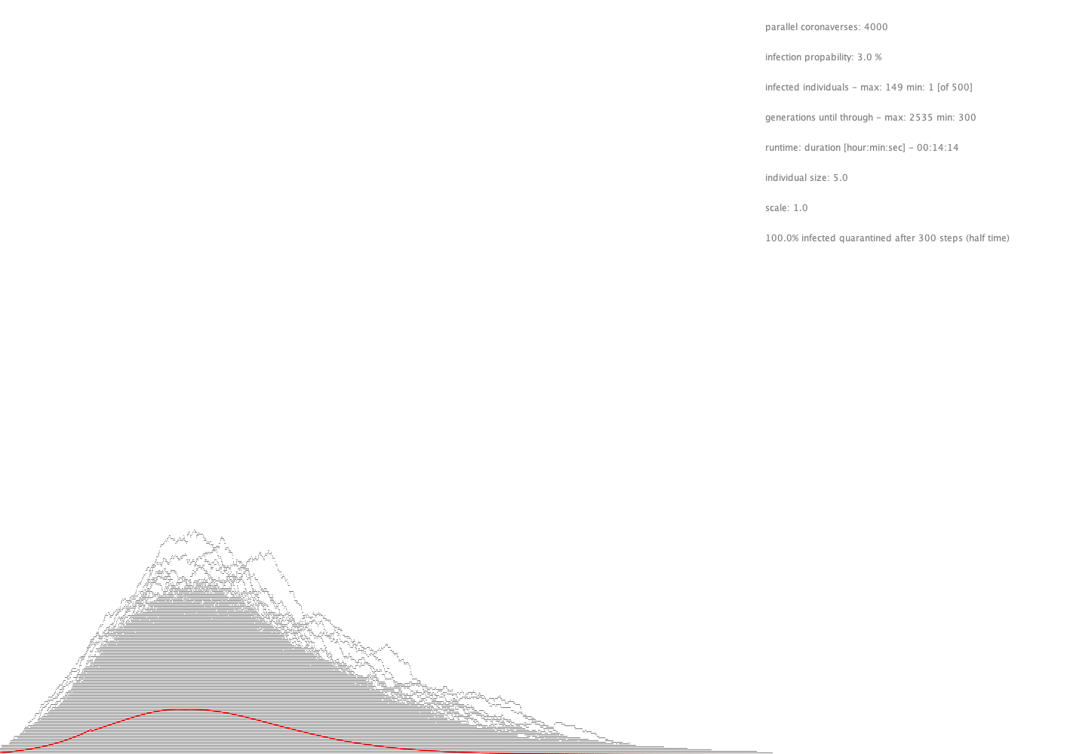
100 %
100% quarantined after 300 steps
3500 steps

Slide 44
Quarantine time

Slide 45
100 %
1% quarantined after 300 steps
3500 steps

Slide 46
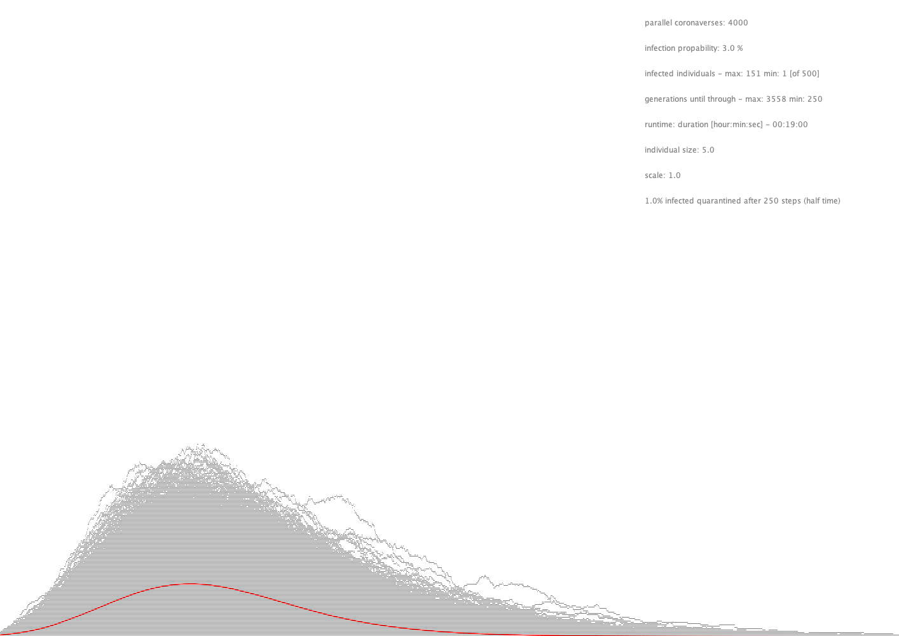
100 %
1% quarantined after 250 steps
3500 steps

Slide 47
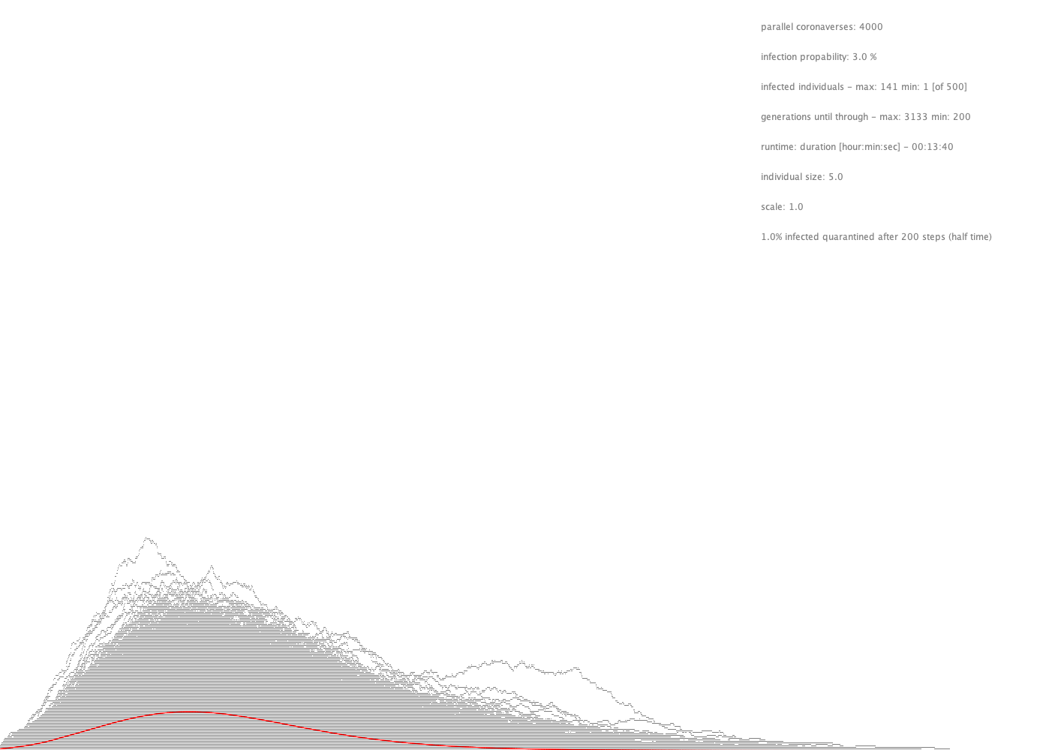
100 %
1% quarantined after 200 steps
3500 steps

Slide 48
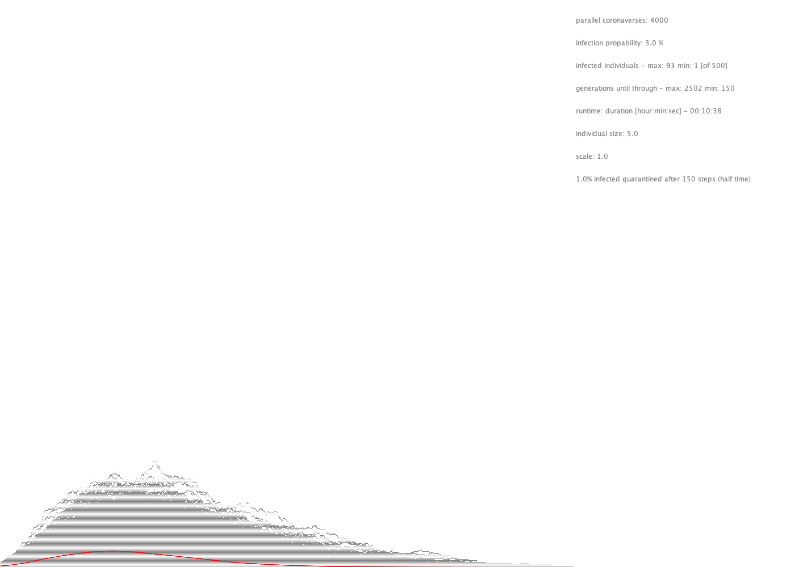
100 %
1% quarantined after 150 steps
3500 steps

Slide 49
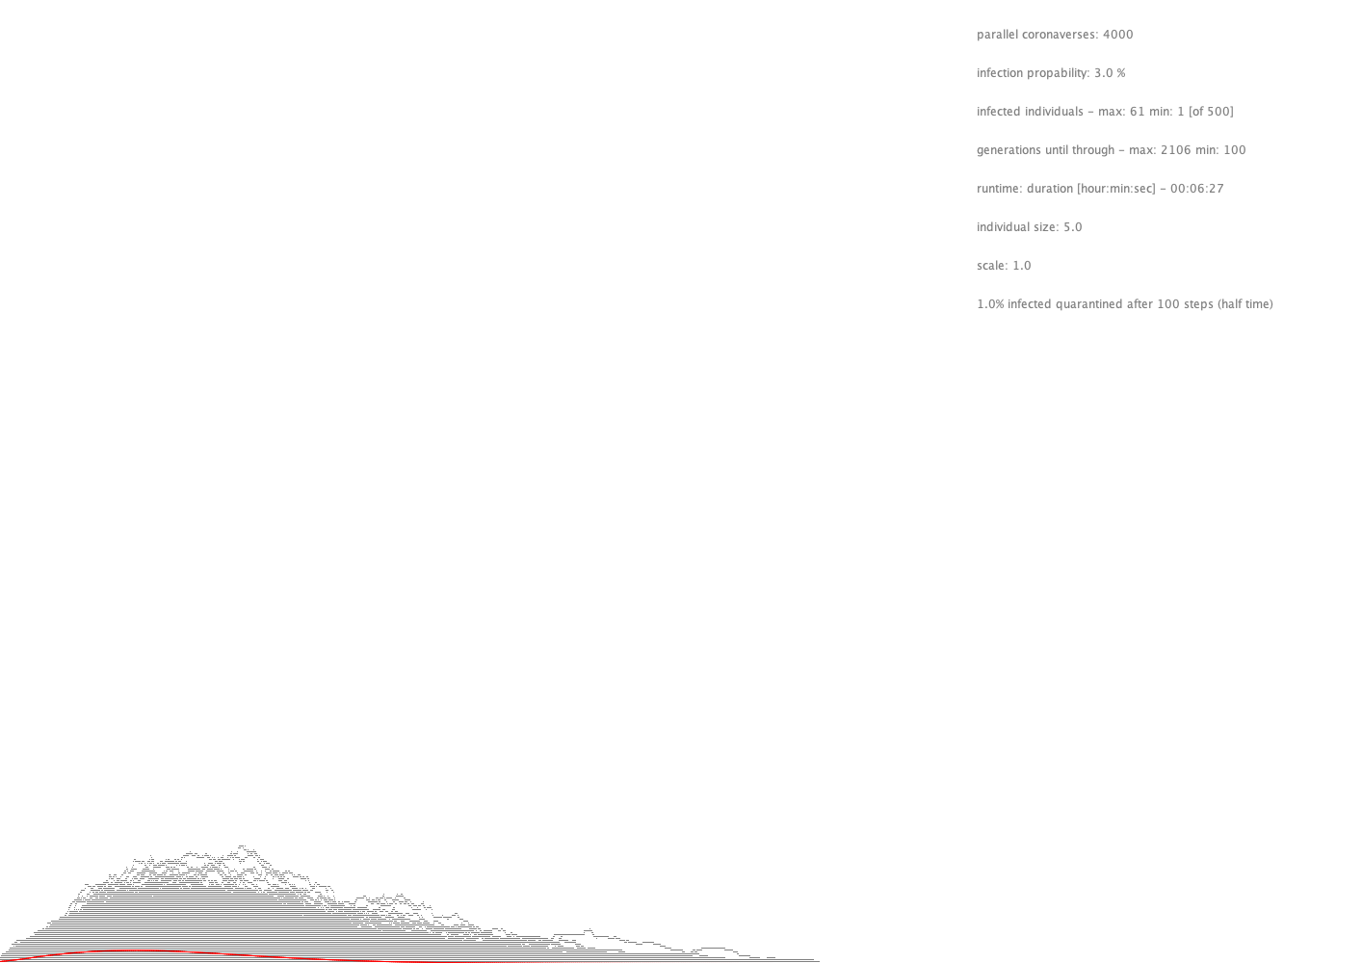
100 %
1% quarantined after 100 steps
3500 steps

Slide 50
Learnings
Detecting infected individuals after half time of recovery time (here 300 of 600 steps) and sending them to quarantine has good effect on the curve. This is especially true for smaller numbers in the range 0.1% – 10%. Higher numbers show almost ‘no’ effect.
The sooner infected individuals go to quarantine the flatter curve. This measure is the most effective measure and therefor highly recommended.

Slide 51
Next steps (advanced)

Slide 52
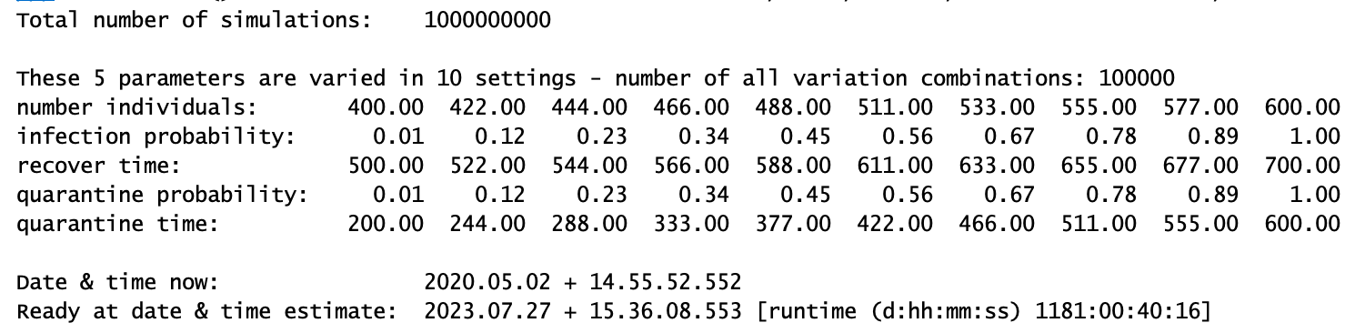
Modelling the system
Calculating by “sampling the whole space” is prohibitive due to limitations in computing time (5 Parameters in 10 discretisations lead to 1 Million combinations, to 1 Billion simulations, resulting in 1181 days computing time on a desktop computer.

Slide 53
Modelling the system
The idea is to learn the model. Thereby a smaller subset of parameter combinations is calculated bringing calculation time down to some days.
This output is taken as the input for a Neural Network. The NN has n input nodes and m output nodes. Thereby n is e.g. 5 (see above) and m is set, depending on desired resolution (e.g. 100).
The next step is to learn probability distributions “produced” by certain input parameter settings. Again, depending on the desired output resolution, the number of m output nodes can be chosen to be 100 x 100 = 10.000.

Slide 54
Dream – Applying the model
Varying n input parameters result in probability distributions for infections over time.

Slide 55
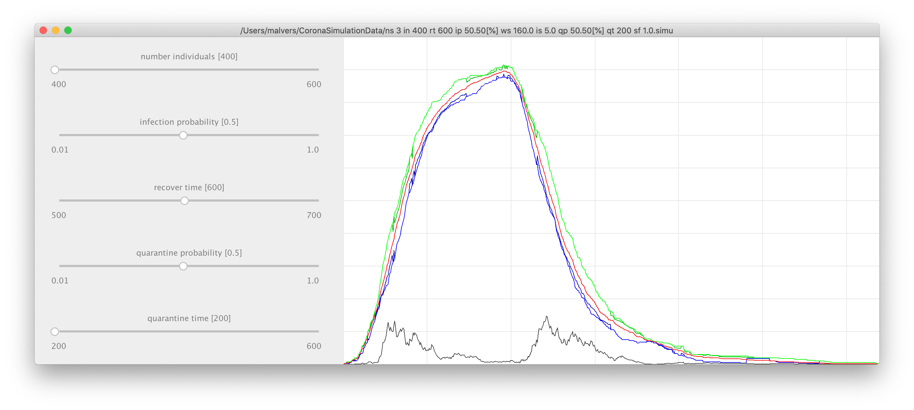
Work in progress

Slide 56
Source code available on GitHub
https://github .com/malvers/RandomInfectionSimulation
Code review is highly appreciated!
michael.r.alvers@gmail.com

Slide 57
Appendix

Slide 58
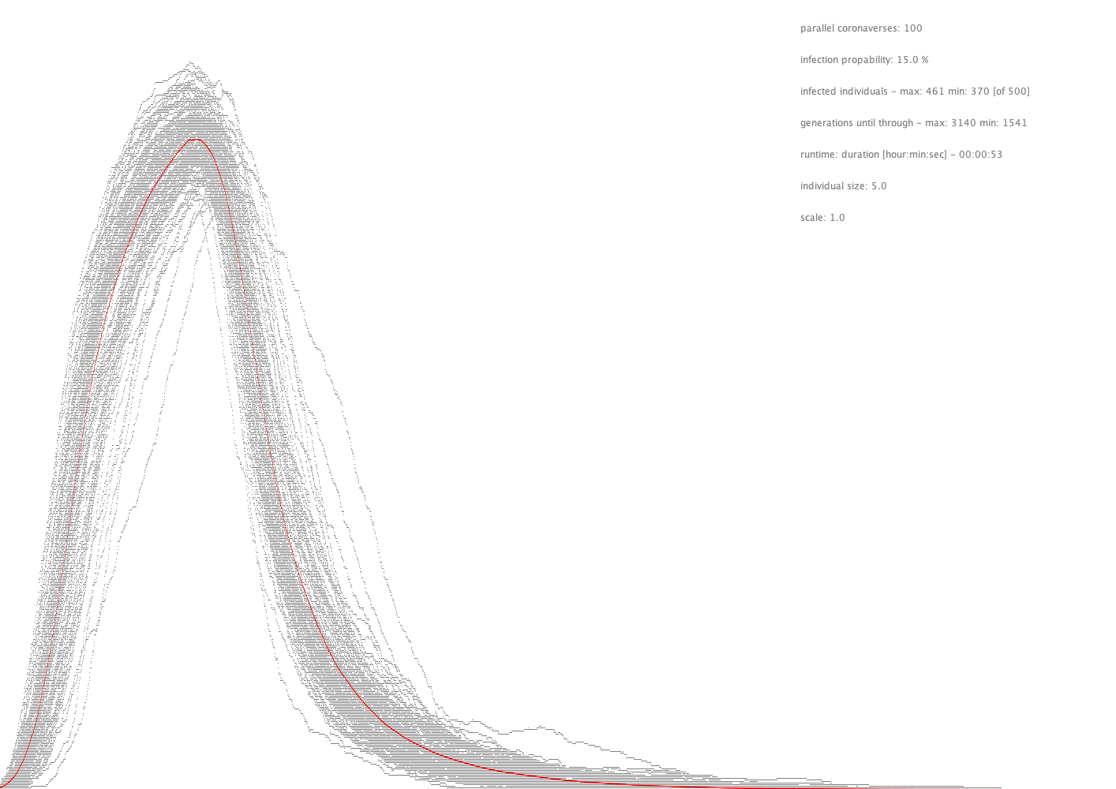
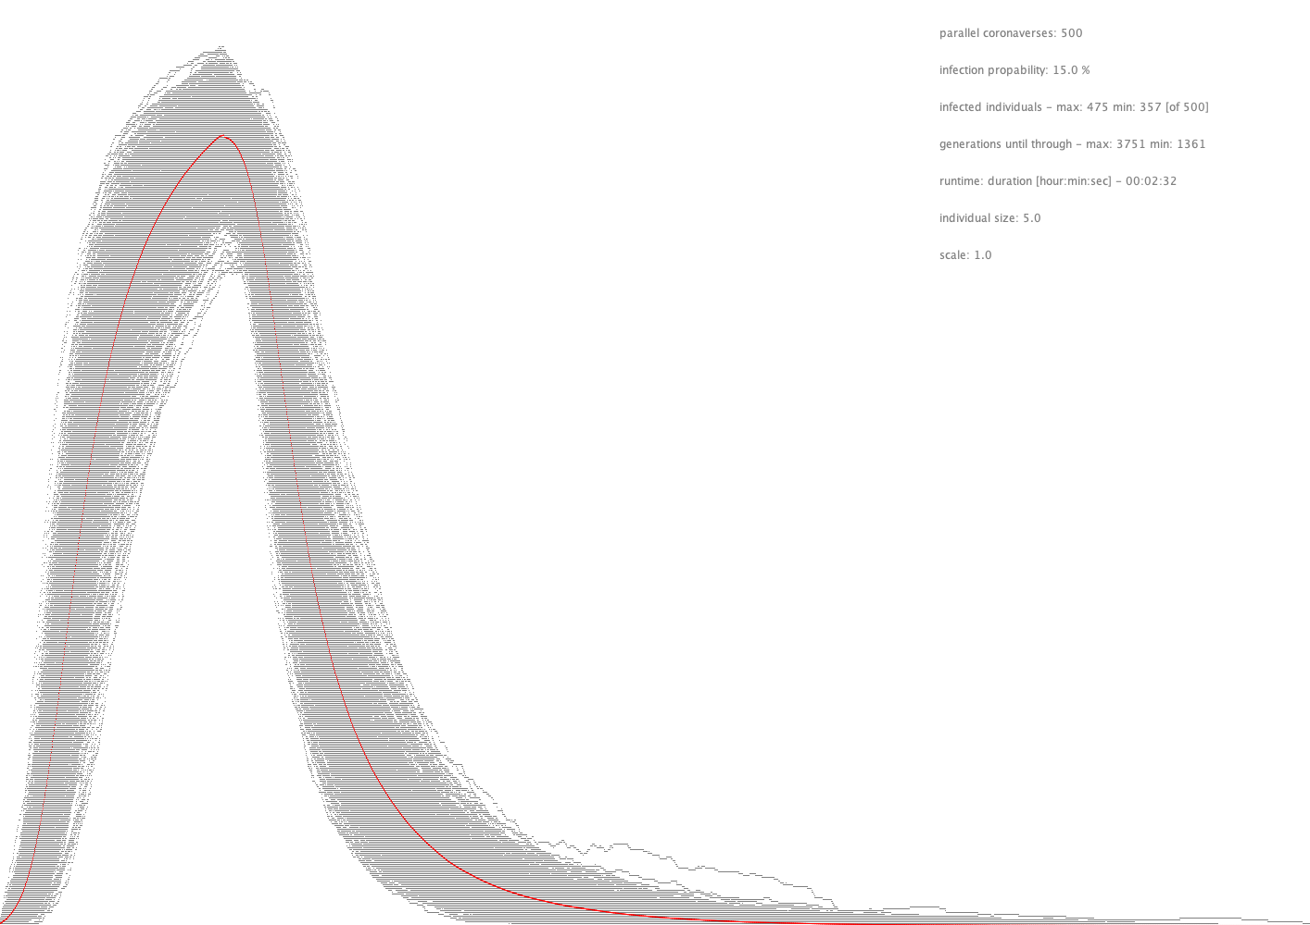
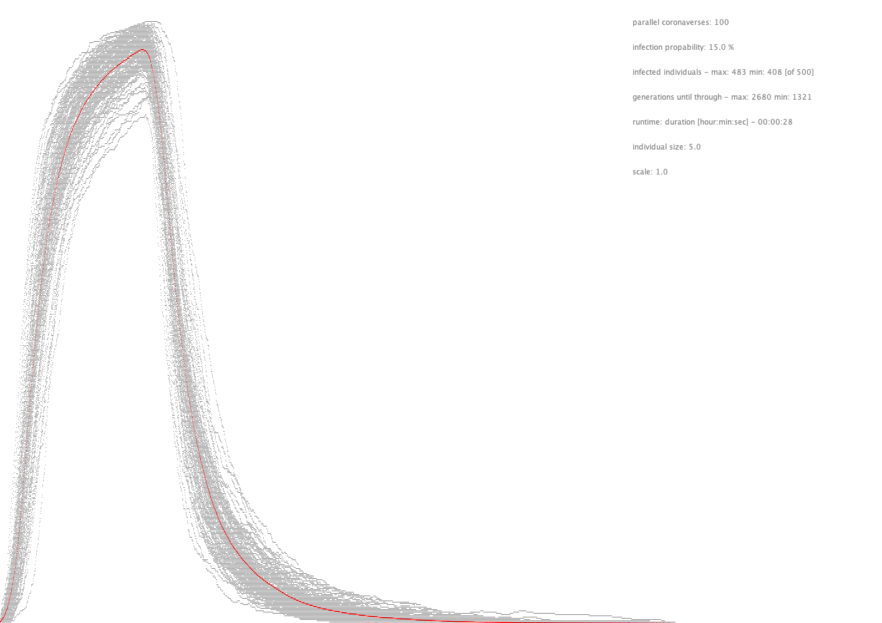

Box check and distance check are equivalent
inner
box
outer
optimized

Slide 59

Comparison MacBook PRO i9 2.3 GHz (2020) vs. i7 2.8 GHz (2012)
1:12:17
00:35:18
sin palabras ...

Slide 60
Create all variations of i parameters in j settings
j
...
...
i
examples between the extremes all left and all right

Slide 61
Layman Solution ☺
Create all combinations with repeats of all possible settings.
example of 3 settings for 5 parameters (243 combinations)
possible variations for 3 settings

